Slide 1
Seeds of Success
Lifestyle Selling: Managing the Sales Process with Buyers
Session Three

Slide 2
Goals of This Session At the end of this session, you’ll have the tools to:
Differentiate between lifestyle selling and traditional selling
Create an effective qualifying process with buyers
Assemble the materials needed to counsel and qualify buyers
Ask effective qualifying questions with skill
Be able to use the Better Homes and Gardens® buyers’ presentation
Handle five common buyer’s objections to move buyers through the purchasing process
Decide whether a particular buyer is qualified to work with you to uphold your standards for buyers
Create a dialogue for buyer loyalty
Notes:
P. 1 of Student Guide

Slide 3
Resources for Session Three
Buyer’s home information form
Evaluate your buyer’s potential
Quick qualifying questionnaire for buyers
Tracking qualified buyers
Open house evaluation
BHGRE® buying consultation presentation
CMA Software
Videos
How to Question Buyers to Find Hidden Needs
Accelerate training video: Qualifying Buyers
Accelerate training video: The Buyer Interview
3
All materials and videos can be found at http://bit.ly/seedsofsuccess
Notes:
P.2 of Student Guide
Review resources

Slide 4
Lifestyle Selling
The Better Homes and Gardens ® website helps clients choose their lifestyle preferences
Notes:
P. 3 of Student Guide
ASK: How many of you believe there has been a fundamental shift in consumer behavior? Explain digital age
Use checkers versus chess analogy
ASK: What do brands like Harley, Apple, and the Ritz have in common? They are lifestyle experience companies.
The ante is customer service – it is the minimum standard. Prior to the internet, the focus was on functionality such as 3 bedrooms etc.
Now, the consumer is much more interested in lifestyle. Explaining this fundamental shift and how BHGRE is a lifestyle company can a big competitive advantage with your potential clients.

Slide 5
Differences Between Lifestyle and Traditional Sales
Traditional
Focused on transaction
Buying a home
Features of the home
Lifestyle
Focused on the buyer experience
Community match
‘Lifestyle’ selling matches the values and image of the brand.
Notes:
Traditional: interview buyer for 3 bedrooms, etc.
Lifestyle: interview buyer for lifestyle preferences (community, schools, biking, golfing, etc)
P. 4 Guide

Slide 6
Differentiating Yourself with the Lifestyle Approach
Technology empowers consumers to be part of the process
Become a coach and collaborator
Share the process
Educate about communities
Communicate to their preferences
Relationship/connection/ collaboration—forever!
You are relevant before, during and after the transaction!
Notes:
P. 5 of Student Guide
ASK: What does an agent like this do?
Become a lifestyle specialist – give examples, know average days on market, view all of the properties, know the schools, restaurants, and anything that is going on in the community.

Slide 7
Matching Buyers to Lifestyle
Look, Learn, and Live sections on the Better Homes and Gardens® website
Find a Community section
Consumers can select criteria to find the right community
Online tools: housing trends, schools, demographics*
*Agents can use these tools on their websites, emails, eNewsletters, etc.
5-6
Notes:
Check your questionnaire: what questions address lifestyle?
NEW WEBSITE: innovative lifestyle search
Where Do You Want To Live

Slide 8
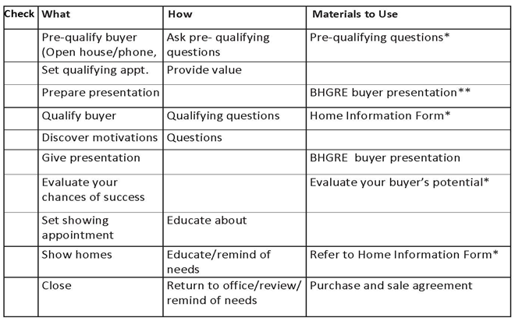
Your Buyer System
Notes:
P.6 of Guide
THIS IS YOUR BUYER SYSTEM: That’s what we’ll do today

Slide 9
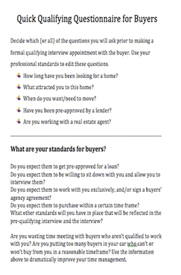
The Pre-Qualifying Interview Questions
Use prior to meeting buyers in formal interview
Create 4-5 questions that would cause you to go ahead or stop before formal qualifying interview
This document is available for you
Video resource: Accelerate Training video: Qualifying Buyers
Notes:
P. 7 Guide
ASK: Why do we pre-qualifying?
question to determine whether to meet with that person
Source: how did this person hear about us? web? agent network?
Interest: what are they interest in?
Experience: have they bought and|or sold a home before? what real estate experience do they have?
Time Frame: when do they plan to buy|sell?
Financial Capacity: what is their financial capacity or situation? do they have money for a down payment? have they been pre-qualified? what is their payoff for their current home?
Decision Maker: who will be involved in the decision making process?
Concerns: what are their concerns?
Objectives: what are their objectives for buying|selling?
Review: go back over the information they just gave you - HINT: use their exact language - do NOT improvise.
Next Steps: explain next steps and set an appointment.
BUYERS HOME INFORMATION FORM

Slide 10
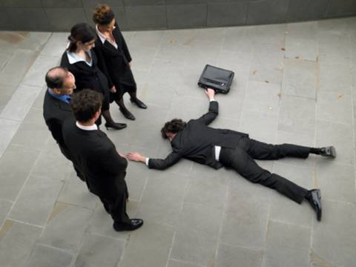
Knock-Out Questions
What would cause you NOT to work with a buyer?
Working with another agent?
Just looking?
Going to buy in a year?
Has no money?
What are your standards?
Notes:
P.7 Guide
Based on the pre-qual questions what are some knock-out questions?
Review the Quick Qualifying Form
Set face-to-face appointment
P. 8 Student Guide – ideas for the pre-buyer packet

Slide 11
The Qualifying Interview
Qualify: Ask
If qualified
Educate
Ask questions first!
Cultivate
If not qualified, do not proceed
Show how you work – ask for loyalty
Notes:
P.9 of Guide – This is the buyer consultation or called qualify buyer in materials
REVIEW SLIDE 8 – where we are in the process
ASK: What percentage of the time should you be talking? Time talking: ¼ of the time

Slide 12
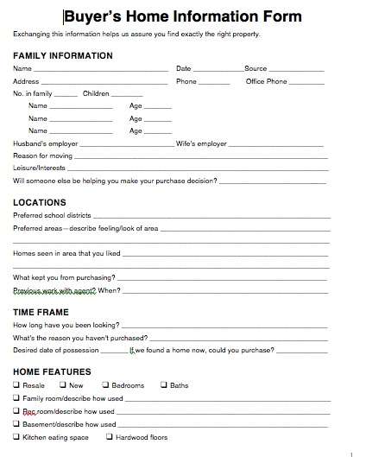
The Qualifying Interview
Three goals:
Qualify the buyer to work with you
Demonstrate how you work
Ask for and get loyalty
This document is available to you.
Video resource: The Buyer Interview available at http://bit.ly/seedsofsuccess
Notes:
P.10 of Guide
Why is this important?

Slide 13
Goal #1: Are They Qualified to Work with You?
Ask qualifying questions
Discover motivations
Discover barriers
Discover competition/previous experiences
How to deliver:
Their home/office
Virtual office: the Cloud/video chat
Use the right communication for that particular client
Notes:
Chat; questions that reveal lifestyle
Chat: questions that reveal motivation
P. 11 of Guide This is the face-to-face buyer consultation meeting
What do you mean by that? Tell me more.

Slide 14
Goal #2 of the Interview: Show How You Work
The services you’ll provide
How you choose clients to work with
How you chose the homes
Why you don’t choose particular homes
How these homes may fit their needs
The route you’ll take (maps, resources?)
Create visuals to support your dialogues
Notes:
P. 11 of Guide Buyer Consultation
Jot down what you’ll say; provide
AT SOME POINT EXPLAIN THE HOME BUYING PROCESS and continue to reinforce

Slide 15
Goal #3 in the Interview: Getting Loyalty
Loyalty is important
For your own self-esteem
To establish long-term relationships
To ensure the client can count on you
When to do it:
In the qualifying interview or buyer presentation; or,
After first tour
Develop benefit-focused dialogue.
Notes:
P. 12 of Guide Buyer Consultation
When and why to gain loyalty
How is on the next slide

Slide 16
Loyalty: Benefits to the Client
Agent gives better service, knowing he/she will be paid
Agent spends more time, less pressure, knowing buyer will buy from that agent
Buyer can expect higher level of service from the agent since buyer and agent have established mutual trust and confidence in each other
Notes:
P. 12 of Guide
How to get loyalty- GET BUYER REP AGREEMENT SIGNED

Slide 17
Putting it All Together: The Complete Buyer Presentation
Use to educate the buyer
Builds on the qualifying interview
Shows your professionalism
Raises your credibility
The Better Homes and Garden ® Real Estate buyer presentation is available under the Marketing Tab in the Greenhouse
Notes:
P. 12 of Guide BUYER PRESENTATION
REVIEW SLIDE 8 WHERE WE ARE IN THE PROCESS
Questions: push back to whole buyer interview
Everything you are doing is to demonstrate that you are a professional and are setting the stage for the whole process
You want the buyer to listen to you and cooperate during the process

Slide 18
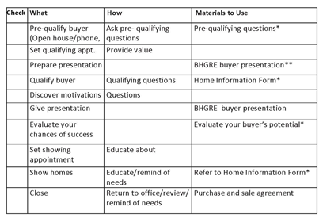
Where We Are in the Buyer System
Is buyer qualified to work with you?
How you work
Ask for loyalty
Notes:
P. 13 of Guide PART - we are now at buyer presentation
REWIEW WHERE WE ARE

Slide 19
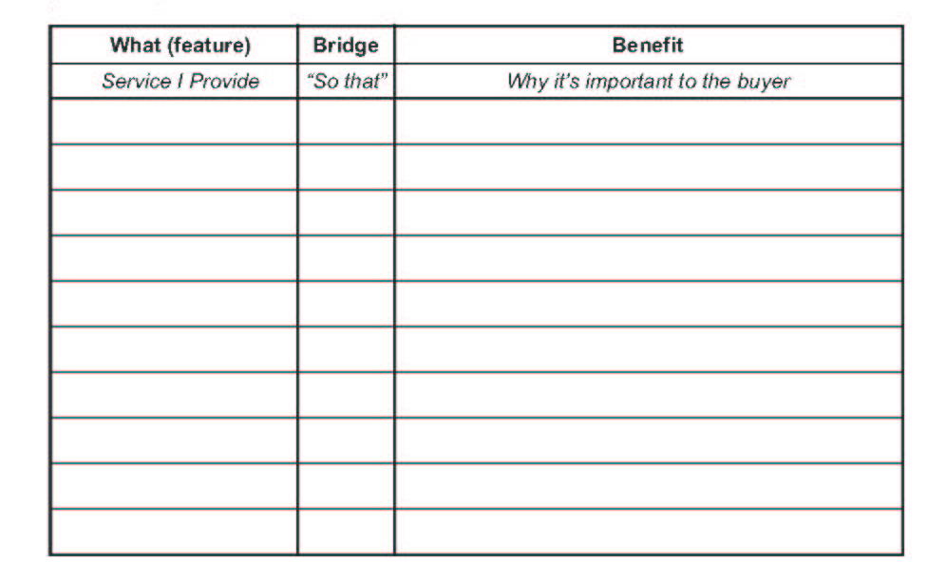
The Value-Added Services You’ll Provide
What can you show to substantiate your claims of value-added service?
Notes:
P. 14 & 15 of Guide PART OF BUYER PRESENTATION
Write 3 value added; add benefits
Show
Always, why this is important and any competitive metrics – example: I have successfully negotiated 4 out of 4 multiple offer situations.
Chat: examples

Slide 20
Example of Some Value-Added Services
Communicate with you on the time frame you desire/and how you desire
Watch for new listings that meet your needs daily
After you’re made an offer on a property, report the progress of your transaction to you regularly
Where in the buyer process could you discuss your value-added services?
Notes:
P. 14&15 of Guide PART OF BUYER PRESENTATION
Demonstrate and explain what you do as a specialist in the area that they are interested in buying. Demonstrate your knowledge through market statistics.
P. 16 – Talks about why to use a visual presentation – Use the buyer’s presentation in bit.ly/seedsofsuccess

Slide 21
Three Sales Skills to Use in your Buyer Process
Attach benefits to features
Probe for more information
Uncover motivation
Notes:
P. 18 Of Guide PART OF BUYER PRESENTATION
Used throughout process
Always think “what is really important to this person that they might not be saying out loud? Ask more questions if in doubt.

Slide 22
Skill #1: Attach Benefits to Features
Question:
Discover function
Discover lifestyle needs
Think like the buyer:
What’s in it for me?
“This home provides {feature}
so that {benefit}; is that what you’re looking for?”
Notes:
P. 18- of Guide – PART OF BUYER PRESENTATION
Lifestyle – what do you do for fun? What do your kids like to do? Where is your work? How would describe your ideal living situation?

Slide 23
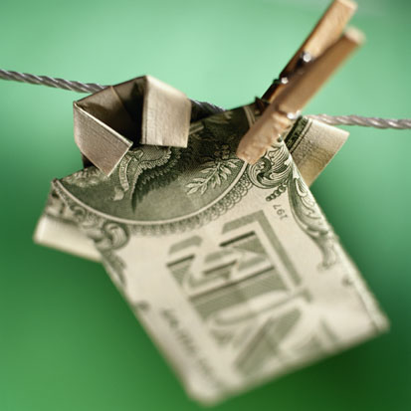
When to Attach Benefits
As you ask pre-qualifying questions
In the qualifying interview
As you present the buyer presentation
Notes:
P. 18 of Guide – PART OF BUYER PRESENTATION
Think of one fact—add a benefit
Always think of why something is important. Most people can’t come up with meaning from a description. Example Country kitchen.

Slide 24
Skill #2: Probing
Probing is a method to find out more about a statement
Question: What do you want in a home?
Probe: Tell me more
Please explain
How will that help you?
Video: How to Question Buyers to Discover Hidden Needs
Point: Keep asking questions about that initial statement until you’re sure you understand the needs of the buyer
Notes:
P. 19 of Guide – PART OF BUYER PRESENTATION
Explain probing. Illustrate how to do this so it is not like an interrogation.
Example: I want a deal. What do you mean by a deal?
GIVE SKILL PRACTICE EXERCISE P. 19 – ROLE PLAY WITH PARTNER THIS WEEK

Slide 25
Skill #3: Discover the Dominant Buying Motive
Motivation:
The underlying emotional reason people make ‘buying’ decisions
Security
Personal Space
Prestige
Important: Must know to help buyers make a buying decision
Notes:
P. 20 of Guide – PART OF BUYER PRESENTATION
Example: buying a new car
Identify DBM: Why did you buy your last home? Chat
DBM = DISCOVERING BUYER MOTIVE

Slide 26
To Discover DBM
Choose a feature buyers want
Attach a benefit
Ask a question about that benefit
Probe
Listen
Which DBM seems to be their dominant ‘theme’?
Video resource: How to Question Buyers to Uncover Hidden Needs
Notes:
P. 21 OF Guide – PART OF BUYER PRESENTATION
Example: Pam and Tom—2 kids; wanted a prestigious area; bought in child-protective area
Use BUYERS HOME INFORMATION FORM

Slide 27
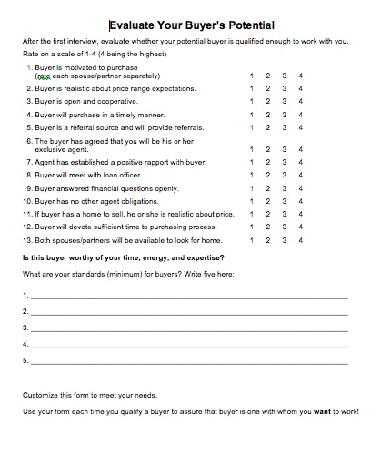
After Qualifying: Evaluate Your Buyer’s Potential
Who are you willing to work with?
What are your standards?
Who wouldn’t you work with? Why?
How’s your time management?
This document is available to you
Notes:
Page 21 of Guide
ASK: What are 3 criteria that would cause you not to work with a buyer? CHAT
USE FORM EVALUATE YOUR BUYER’S POTENTIAL

Slide 28
Handling Buyer Objections
Use the AAA Method
A Agree
A Ask
A Answer
Notes:
P.22 of Guide
Review the methodology
Use visuals.
Always go back to needs analysis
Its all about Questions.

Slide 29
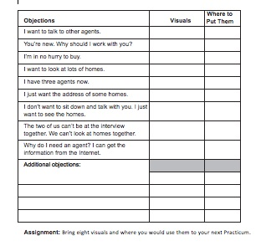
Common Buyer Objections
Practice handling common buyer objections with visuals prior to your next session
Notes:
P.23 of Guide –
EXERCISE COMPLETE THE FORM ON P. 23 AND PRACTICE WITH PARTNER
USE P. 25 of Guide to have your peer partner rate you
Remind them of case studies

Slide 30
What You’ve Accomplished So Far
Lead Generation (Business Producing Activities)
People you know
Circle prospecting
Expired listings
Follow up on Internet leads
Business Support Activities
Buyers’ packages/dialogue created
Your promotional materials
Your marketing follow-up plan started
Notes:
P. 28 in Guide

Slide 31
Accomplishments in Sales Skills
Dialogue for people you know
Dialogue for circle prospecting
Dialogue/process for expired listings
Information for following up on Internet leads
Feature and benefit
DBM
Buyer system flow
AAA
Probing
Use of visuals
Business start-up system
27

Slide 32
What We Accomplished in this Session
Contrasted selling lifestyle with traditional selling
Put together a complete buyer system
Learned how to qualify a buyer
Able to discover hidden drives and needs with 3 sales skills
Evaluated the buyer’s potential to you
Short-term and long-term
Learned how to handle common buyer objections
Found out how to ask for and get loyalty
Notes:
P. 29 in Guide

Slide 33
Recommended Actions to Take Right Now
Work on your Action Plan Checklist
Practice using the Buyer Questionnaire
Using the Evaluate Your Buyer’s Potential, evaluate 3 buyers you are working with now
Practice asking for loyalty
Practice answering 5 common buyer objections with visuals
Watch the referenced videos

Slide 34
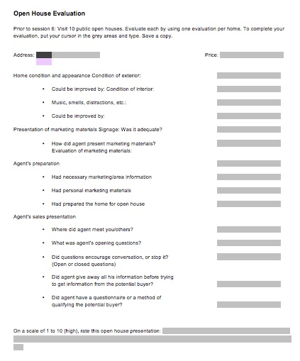
Research for the Open House Session
Using this questionnaire which is available to you at bit.ly/seedsofsuccess, visit 5 public open houses this week and do evaluations on each
Bring the evaluations to your next session

