Slide 1
Seeds of Success
Effective Techniques to
Get the Appointment
Session Six

Slide 2
Goals of This Session At the end of this session, you’ll have the tools to:
Get an appointment on the phone
Handle the common objections encountered on the phone
Ask qualifying questions on the phone
Follow a process to get an appointment on email
Handle common objections encountered through email
Ask qualifying questions on email
Determine who is qualified to work with you
Develop a plan for “Clients for Life”
Get you ready for the Power Hour call session
Notes:
Student handout and facilitator materials page 1

Slide 3
Resources for Session Six
Your marketing plan for ‘clients for life’
Call Session Survey
Your 3 reports
Weekly schedule
Action Plan Checklist
Self-analysis
Notes:
Student handout and facilitator materials page 2

Slide 4
Another Lead Generating Source: Appointments on the Phone or Email
Decide what you want from the call vs. what the caller wants…..
Use the Home Information Form (buyer qualifier)
Use the qualifying questions in this process for qualifying callers
Don’t show the buyer homes if you haven’t qualified them
If the potential client won’t answer your questions, you should… (standards)
Notes:
Student handout and facilitator materials page 3

Slide 5
Critical Telephone Skill for Getting Appointments on the Phone or Email
Follow the three steps here: First, give a feature that the caller has told you is important to him/her. Then, attach a possible benefit. Finally, ask the caller if that benefit is important to him/her. Here’s the process:
Notes:
Student handout and facilitator materials page 4

Slide 6
A System for Qualifying Potential Clients on the Phone or Email
Ask, “What attracted you?”
Ask caller to read ad or promotion (or identify it)
Using that feature, use the process of feature-benefit-question
Probe
Ask qualifying questions
Make appointment
Notes:
Student handout and facilitator materials page 5

Slide 7
Qualifying Questions
How long have you been looking?
Been pre-qualified/pre-approved?
Working with other agents?
Home to sell?
When do you have to move?
How many homes have you looked at?
What’s stopping you from purchasing?
Notes:
Student handout and facilitator materials page 6

Slide 8
Communication Guidelines
Ask questions/probe
Let them talk ¾ of the time
Don’t interrupt
Pace and mirror the conversation
Don’t give away all the features
Your goal: Qualify and make an appointment (to formally qualify or to show)

Slide 9
Handling Objections on the Phone or Email
Use the AAA Method
A Agree
A Ask
A Answer
Notes:
Student handout and facilitator materials page 7

Slide 10
Common Objections
Just want the address
Have an agent
Just looking
Meet at the home
Other ads/promotions/signs to call on
Notes:
Student handout and facilitator materials page 7

Slide 11
Example: AAA Method
“Just looking”
Agree “Yes, it’s important to get a sense of the market.”
Ask “What are you looking for?”
Probe
Answer “Based on what you’ve told me, this fits what you’re looking for. Let’s take a look and see.”
Make appointment.
Practice handling 5 common open house objections for your next session.
Notes:
Student handout and facilitator materials page 8

Slide 12
Skill Practice: Answering Incoming Calls
Practice the entire method, using the simulated calling situations (can use email simulations, too)
Use the evaluator to prepare for and evaluate performances
Notes:
Student handout and facilitator materials pgs. 9-13

Slide 13
You Got Them—Now Keep Them! Create a ‘Marketing Plan for Life’
Past clients are much less expensive to keep than to get a new client
Focus on long-term relationships, not just that sale
Develop a system
Schedule the whole year
Benefit: Saves you time and money!
Put your schedule in your CRM
Notes:
Student handout and facilitator materials page 14-15

Slide 14
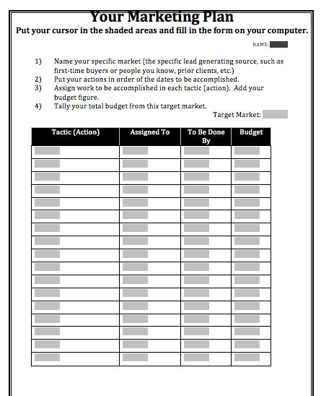
Your Marketing Plan
What you’ll do
When (monthly)
Who you will target
How
Resources
Budget
5-10% of projected income
Notes:
Student handout and facilitator materials page 14-15

Slide 15
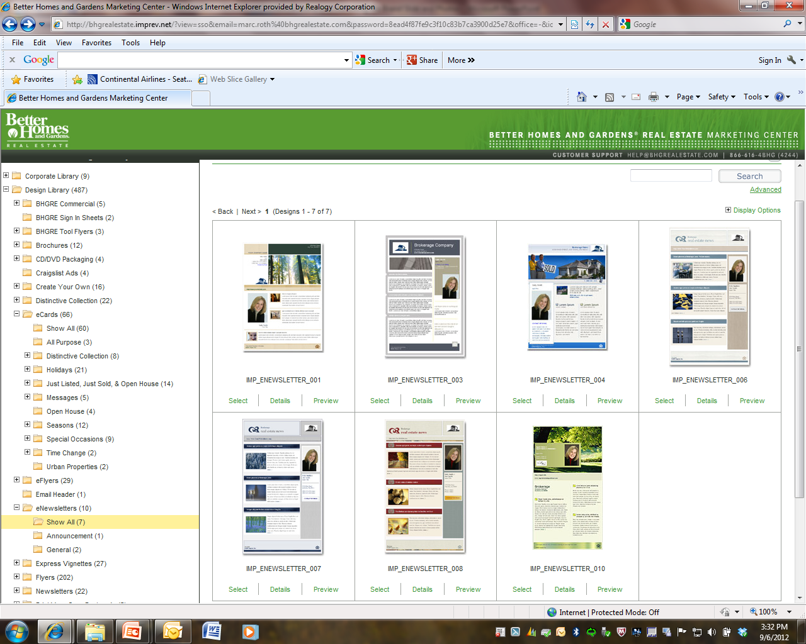
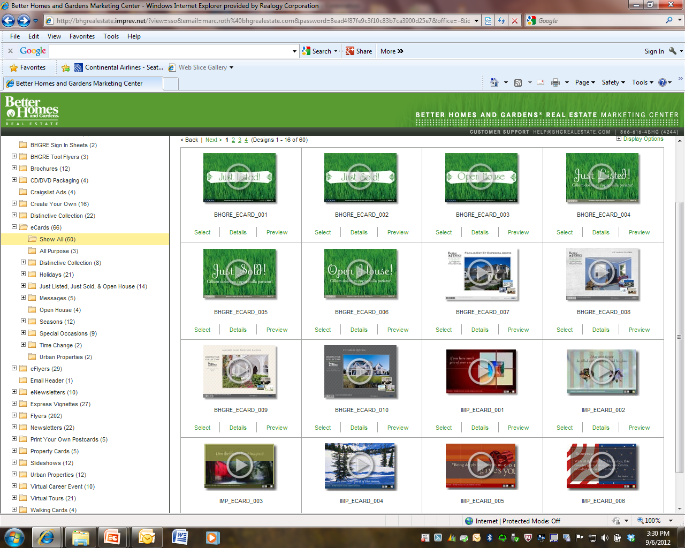
Greenhouse Resources for You
CRM
DMC
Better Homes and Gardens ® Magazines
Also:
Post Cards
Flyers
Email Templates
Anniversary cards
MARCH 2011
Check the Greenhouse for dozen of marketing ideas.
Notes:
Student handout and facilitator materials page 18

Slide 16
Steps to Take Right Now
1. Build a call list of 25-30 people
2. Talk to your coach about dialogue and approach
3.
Notes:
Student handout and facilitator materials page 22

Slide 17
Who Are We Calling? Everyone and Anyone
Open House Attendees
Invite People to Open Houses
Past Clients for Referrals
Internet Leads
Sphere of Influence
Farm Area
Expired Listings
FSBOs

Slide 18
Time To Book Some Appointments
Good Luck!
Notes:
Student handout and facilitator materials page 22

