Slide 1
Seeds of Success
Implementing Your Lead Generating Plan with Best Sources
Session Two
Notes:
Good Afternoon/Morning…..How is everyone today?
Possible questions: Who has warmest weather? What’s the temperature where you are right now?
Okay…welcome back! Congratulate yourselves are making it back out today! Commitment is a big pare of success. (Insert story…university grad, mailroom….it showed goals and commitments…showing up, it what separates the good from the great) So, I guess everyone here is great!! As we work through this course and you start prospecting, you will start to see your business pick up, but, still remember to get on these calls….be proactive with your business, don’t let it rule you! Before we get into anything “too deep”…..I am going to run a quick poll…..remember it’s anonymous, we’re not here to “punish” we’re here to help. (POLL….homework, yes or no: time block, goal sheet, efficiency tracker, add 50 people to your database). I just want to see how we’re doing! Great….if you had any challenges to implementation, feel free to reach out and we can help! I hate to put anyone on the spot…..but, did anyone on the call want to share a success that they had in their business last week? Awesome…let’s go!

Slide 2
Housekeeping
Join www.facebook.com/groups/BHGRElearning and share what you learned today #BHGRESEEDS
Email karrie-ann.sheppard@bhgrealestate.com, your coach, mentor, or manager that will be working with you through the program (provide their email address please)
Visit http://bit.ly/SeedsofSuccess to download materials and for videos
Notes:
We’re just going to go over some of our basic housekeeping, it case you forgot!!
We want to do anything we can to assist you in having an incredible year!!

Slide 3
Goals of This Session At the end of this session, you’ll have the tools to:
Create a follow-up system to assure your work pays off
Be able to attach features to benefits
Be able to craft a sales call to your best source of leads
Be able to craft a dialogue for circle prospecting
Create your marketing (including social media) and technology plans
Notes:
Today is a BIG day, now that we have some of our foundation in place….we want to discuss how to communicate our value with everyone we know! Real Estate is a “touch” sport…….the more we can get out and talk to people, the greater the likelihood of uncovering leads! That’s one thing I love about real estate…is everyone that you know, meet, speak with is a “suspect” (not necessarily a prospect) but, a “suspect”……fortunately the majority of people you interact with on a daily basis have a roof over their head…..whether they are current homeowners or aspire to be.
So today our goals are: (read)

Slide 4
Resource List for Session Two
Materials available at http://bit.ly/SeedsofSuccess
Suggested Script for Calling/Emailing people you know
Circle Prospecting Suggested Script
Videos available at in Greenhouse Learning Tab
Accelerate Training Video: Outbound Sales Call
Accelerate Training Video: Profitable Prospecting
Accelerate Training Video: Calling Your Sphere
Lots of support for this training session!
Notes:
Hopefully you’ve had a chance to review the material for class…if you haven’t but sure that you do, don’t miss out on some of the best information available to new in the indusrty!
Materials, for this class and all subsequent classes will be available at: bit.ly/seedsofsuccess (see above)

Slide 5
Follow-Up System: Make Money from Leads
Decide on a follow-up based on your rating
When will you mail? What?
When will you email?
When will you call?
When will you meet them in person? For what reason?
Video resource: Converting Leads to Clients
Check out CRM training in the Greenhouse
Notes:
One of the most important systems that you will want to create is your follow-up system…..this is where some of even the best agents out there fall to the wayside. We’ve all been here….have you ever promised yourself that you’d get back to someone on a certain day and for what ever reason….you didn’t? But at the end of the day, you tell yourself…that’s okay, I’ll do it first thing tomorrow…no big deal. Then tomorrow comes and you don’t call….BUT, promise yourself again that you’ll do it the following day? This can go on a for a few days and then finally you tell yourself…well it’s been so long, now I’m too embarrassed to call!! Does that sound at all familiar? I can’t lie, I’ve been guilty of it……but, when we do that…we leave a lot of money on the table, especially if it’s a lead that contacted us first!!
Now every follow-up plan, will be a bit different, given the circumstances of the lead……but, for each lead you ever uncover, you will want a “plan for attack”. We recommend that as leads come into you…you rate them. This way you can have a “general idea” of how you will handle each type of lead based on its rating. Some of the decisions you will need to make are (read above)……put some thought and strategy into it. Be the professional….consumers expect their Realtors to be professionals. Consumers will often do the math around commissions…..it’s your job to be worth every penny they spend. Consumers know when someones “winging it”….please, do the industry a favour, don’t ever “wing it”.
In your workbook, on page 3, we’ve provided you with a very good “rule of thumb”. Make contact at least once a week for the first 8 weeks, to ensure that they know you. In the Greenhouse, you could even created a great weekly touch campaign for new leads. Now, in the beginning, let your lead demonstrate their preferred method of communication….if someone keeps emailing you, email back. If you want to speak to someone who is constantly emailing you…..it’s okay to ask in a note if you can have a conversation. You do want to have conversations with your clients, they are more personal….but, don’t force it.
For those of you who like a follow up system with calling…..know how you are going to handle voicemail. With caller ID…..please don’t hang up, know what you want your message to be. Something to consider….when I leave a voice mail, I always end it with giving myself permission to call back, so that calling again is expected…...for example, “I know how busy like can be and the last thing I want to do is add to your “to-do” list, what I will do, so that you don’t have to worry or think about it….is I will call you back on Thursday between 5 & 5:30…I hope that helps and if you want to speak soon….by all means, call”. This way I’m not a “stalker” when I call again, I’m just keeping my word.

Slide 6
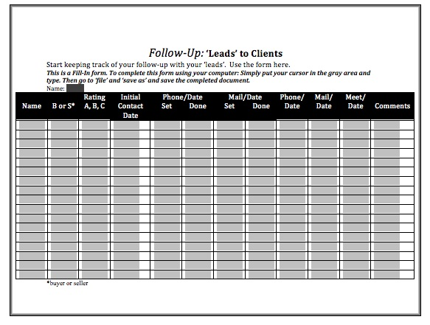
Follow-Up System: Make Money from Leads
Rate them A (best), B or C
Check Do Not Call laws
This form is available to you
Check out CRM training in the Greenhouse
Video resource: Converting Leads to Clients
Notes:
If you go to the forms section of the bit.ly site, you will find the “Leads” to Clients form. It’s fairly straight forward…..but, very powerful in getting “noise” out of your head and on paper. You simply enter the name, note whether they’re a buyer or seller……Rate them……so for me “A” is someone who is looking to close within the next 120 days, b are people who are looking to close 5-12 months out and everyone one else, is “thinking, if the situation was right”….non committal.
Rank them and note when follow up activities will or have occurred. Once you have had contact….decide when you want the next contact to be. If you were using these sheets manually….I’d get a red binder (my hot leads binder) and put them in 12 months…..put a few sheets in each month and when I pick my follow up times, I’d go to the month and write the information down. Or if you want to do it via technology and calendering, by all means use your phone/calender. Again…your business is yours, the best method to use is the one that work for you!

Slide 7
The Most Important Sales Skill: Attaching Benefits to Features
A feature is: _________
A benefit is: _________
Think like the ‘recipient.’
What’s in it for me?
Notes:
Student handout and facilitator materials page 4
One of the most important sales skills you’ll need to do to create great value is know the difference between a feature and a benefit and how they relate to each other.
Does anyone know the difference between a feature and a benefit? (it can be hard to articulate)
An easy way to look at it is: a feature is essentially a surface statement about a product or service.
A benefit: is the result one would obtain in using or leveraging a feature.
A feature essentially draws an outline, the benefit is what colours it in….without the benefit, people may not always interpret why a particular feature might be important or even worse, they may perceive the feature in a negative light. For example, if I market a car as FAST….some people may think it sounds exciting, others may think it’s dangerous…..so I have to explain what a benefit to a fast car may be…such as, it can go from 0-60 in 2.5 seconds ensuring the safety of passengers when making turns.
An example a feature for a car might be good gas mileage….the money you save driving it is the benefit.
Or a feature may be “home delivery”….the time and headaches you save not having to make pick up arrangements in a benefit.
So in real estate, we have to learn how to present features and benefits in 3 different contexts: the home itself, services to the buyer and services to the seller.

Slide 8
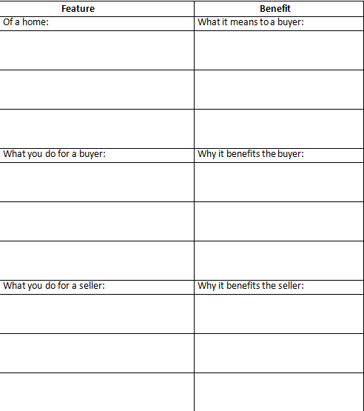
Practice: Features to Benefits
Review NAR Guide Field Guide to Fair Housing
Notes:
Student handout and facilitator materials page 5
So we have an exercise on page 5 of our workbooks. We are going to break off into different groups to leverage more minds to create feature and benefits with regards to real estate. You’ll see it’s broken into the 3 categories I just mentioned. I will give you an example of each to get you started and then in your groups you will have 10 mins to create the other two.
Ok: home: This home has a large dining room making it perfect for entertaining friends and family without the risk of “running out of space”/bumping elbows/eating in a different room. Make sense?
Buyer: I spend the last hour of every night personally visiting homes listed for sale, I have found this cuts the average buyer’s search time in half, as we are not just dependent on computer parameters as to the viability of a home, I’ve seen most of them and can speak to you in detail about them before you commit to viewing.
Seller: I am a strong negotiator, in fact I am on average negotiating at a rate 10% better than anyone else in my marketplace, meaning my clients walk away with, on average an additional $10,000.
Go to break out….10 mins.

Slide 9
First Lead Generation Method: Contacting People You Know/Meet
Why?
Easiest
Best conversion rates
Contacts want to help you
Requires little sales skill or experience
Lowest cost/highest return
Notes:
Student handout and facilitator materials page 6
Now we know how to create value in our communications…that means it’s time to start actually contacting people! This is where it starts to get fun and we can start making things happen!! Okay……last week we asked you to add 50 people to your new “database”, in essence, we ultimately want everyone we meet/speak to/know to end up in our database and start communicating with them, with that…we have to start somewhere!
That first and most natural place to start generating leads is through people we already know and have met. These people are easy….they already know and like us. We likely already talk to them time to time….so calling them shouldn’t be too difficult. I’m not a “phone lover”…but, this group of people, I can call…..we have a relationship. We tend to have great conversion rates with these people……they sincerely care and want to see us succeed, it will make them feel great to be a part of that. Because of the emotional connection….we don’t have to have incredibly sharp sales skills, we can incredibly transparent. We don’t have to invest too heavily in them to start up. (as long as we know that as we grow, we never take them for granted). These are great people to try new things with, learn from them…what questions do they have, what do they want to know. They will be pivotal in assisting you learn and grow!

Slide 10
Lead Generation How to Craft a Sales Call (Contact)
Think of a particular person
Determine a potential real estate need
Write 3 questions you’ll ask to uncover that need
Determine your ‘call objective’
Write a question to get an appointment
Write an opening statement
Video resources: Calling your Sphere is available at http://bit.ly/SeedsofSuccess
A dialog is available to you, and a worksheet is on page 6 for you
Notes:
Student handout and facilitator materials page 6 & 7
Let’s get ready to make our first call! Now, has anyone read Jeffrey J Fox’s, “How to Become a Rainmaker?”
In this book, Jeffrey explains, and I quote, “A rainmaker always pre call plans. No matter how many years of sales experience they have, they never wing it. Do your pre call homework before every call. Never dial or show up to an appointment empty handed”
So go through this exercise prior to every call, PLEASE. It will keep you focused and help you to visualize an end result!
There is a great example on page 6 of your manual and exercise that you can work through on your own. Be sure to work through this exercise and for those of you who really want to kick it up a notch….role play it out with your mentor/accountability partner. I suspect, I just made a few people cringe at the thought of roleplaying, I know it’s not many people’s “favourite” thing to do….but, it works! It helps to build confidence, it helps you internalize your messaging, it helps you proactively trouble shoot any miscommunications……if you choose to not role play, make sure your first 4 interactions of the day are not important ones, because they will actually end up being your role play partners.

Slide 11
Where to Find Those 50 People
Where to find these people:
Your friends/family member’s friends
Your high school/college friends
Services you use (hair cuts, gasoline, grocery store)
Your holiday card list
Association members, hobby members, charity members, those with similar interests
Your former co-workers
Notes:
Student handout and facilitator materials page 9
So last week we asked you to write down 50 names….essentially it is the start of your database. Databases are gold to any sales professional, top producing agents earn anywhere from 75-85% of their business from their databases. On the other side, agents who ignore their databases, leave on average, $50,000 in GCI on the table any given year. Now 50 people a week, can sound like a lot…but, as you saw in the workbook….they can come from a multitude of places…..you’d be surprised how quickly your database can grow! Depending on how you want to build your business….the size of database you need to meet your goals can vary. Personally, I like to operate with a smaller database with a high rate of return over a large database with a low rate of return. If you are treating your database well, as a brand new agent, you will on average earn an 8% return with some experienced agents earning closer to 20%. Meaning that over the course of a year, if you regularly market and “give” to 100 people, you will, on average earn 8 deals.
Now that you have some names collected….your home this week is to put your goal sheet to work. Try to set appointments, or speak with the correct number of people according to the plan. For example, if you had to complete 3 appointments.....that is your goal or you can set a goal to have an actual conversation with 30 of these people. In addition….you will want to add to this list, another 50 names! I know it seems like a lot……but go to your facebook, your address book, your outlook and you will likely find many contacts in place already!

Slide 12
Second Lead Generating Method: Circle Prospecting
Why use this?
Easy to use
Low cost
Puts you in front of people
Little competition
Can do it in small portions of time
Creates expertise in an area
Notes:
Student handout and facilitator materials page 10
Another great way to prospect is Circle Prospecting. Does anyone know what circle prospecting is?
Circle prospecting is prospecting to provide someone with information about a specific property in their area! With things like the do-not-call list, for myself, I find this more effective going door to door. This is a great way to find leads. How many of have noticed that some neighbourhoods NEVER have a “For Sale” sign up until 1 day and then within a week you see 3 or 4? That’s actually fairly typical. I don’t know why that is….Amy, do you know what that happens?
For whatever reason, embrace it! You now have a great reason to introduce yourself and discuss real estate with the neighbourhood! This is a favourite prospecting technique for many reasons namely: read above.

Slide 13
Circle Prospecting Opportunities
Hold an open house
Ask a listing agent for permission to circle prospect the listing
Listing sold: Ask the listing agent for permission to circle prospect the home
Ask an agent who has just sold or closed a home if you can circle prospect it
Video resource: Circle Prospecting
Notes:
Some of the top reasons to circle an area are: just listed, just sold, open houses, price reductions…….things that future clients would love to know, especially if they are considering a move!
Remember to not do these activities behind the back of your office agents……be transparent. We have to work with these agents in many different ways and sometimes we’re on opposite sides of a deal…..for the sake of your business and future clients…..don’t be a “jerk” realtor.
Many of you likely work with agents who, for whatever reason, don’t do this, especially at busier times of the season……just show them respect and they may be willing to help you out in ways you may not have even asked for. (for example, agents that primarily list homes have been know to refer out buyer clients…..fellow agents can be our greatest allies)

Slide 14
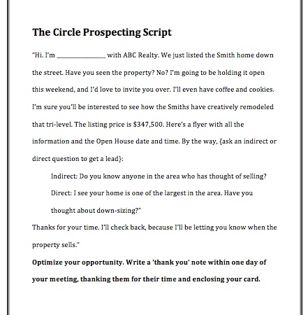
A Dialogue for Circle Prospecting
Reason for contact
Invite them if holding open house
Ask:
“Do you know anyone who…”; or
“Are you…”
This dialogue is available to you
Recommended Action Plan Checklist: Circle Prospect 50 homes prior to next week
Notes:
Student handout and facilitator materials page 11
We have made available to you in the bit.ly file a Circle Prospecting Script. Now….a note about scripts…..use them. It doesn’t have to be what we create, you can create them on your own or simply tweak what we have. The reason I suggest you use them is…..they WORK. I’m not saying to read things off a piece of paper verbatim….but, internalize the message such that you know it so well, words roll of your tongue without thought. You’ll find, the more you practice your scripts your message with remain consistent, even if the words change. Eat, breathe and live your message!!
One thing I want you to be sure of, is that when you prospect, your conversations need to be consumer centric, not agent centric…..this is about them, not you! The sooner you can communicate something that interests them….the sooner you will have rapport and the greater your odds of uncovering a lead.
For example…if I were to circle prospect an open house….I would stick primarily to that street and say something like, “Hi, my name’s KA Sheppard from BHGRE Best Brand Ever”. I’m not sure if you noticed or not that one of your neighbours homes is for sale and I wanted to let you know we will be hosting an Open House this weekend so if you see a lot of strange cars parking or driving up and down the street, please don’t be alarmed. Also, I noticed the toys in the driveway, can I assume you have kids? How old?….well will be here form 2-4 on Sat, so if you have any concerns, you may want them to play in the backyard or inside, as I said….there will be a lot of strangers on your street that day.”
I made the call about them from the getgo….not about myself or my needs. Do these people, who I’ve never met, trust me? Will they be more willing to open up to me? You don’t have to use that example….but, think of ways to make the news you are going to deliver about a benefit to them!
At the end of the conversation always be sure to “close”, you can use the verbiage outlined in the script or create something similar yourself. Something as simple as Are you planning a move in the near future? (see above)

Slide 15
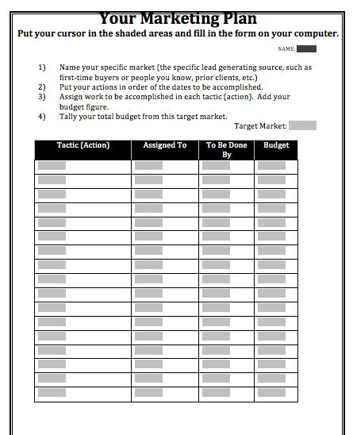
Create Your Marketing Plan
Saves you time
Creates a marketing system
Gives you something to delegate
Helps prove to the potential client or client you run a professional business
Tip: Connect your action plans for prospects to CRM
This form is available to you
Notes:
Student handout and facilitator materials page 12
Alright, we are heading into some more intense learning….so, let’s just give our brains a break for a second. If you want to stand up and jump a few times, go ahead….shake your head around, now’s a great time to do it. Before we start up again, I’d like to ask you all a question……what’s the best gift you’ve ever given your dad? (my dad’s birthday is coming up and I’m at a loss of what to get him) Awesome….I’m going to try one of those things!!
Okay…..now that we’ve got to shake up a bit, let’s get back at it!
So now that we’ve learned how to speak with people, where to find people to speak with……we will also want to start to put a marketing plan in place. Prospecting is your number 1 priority but it’s very time consuming. We need an activity that can run along side our prospecting efforts, something that will operate even when we are not there…..marketing can do just that! It’s also a great way to touch people without being “in their face”.
Why else would we create a marketing plan. (read above unto next page)

Slide 16
Create Your Marketing Plan
Stays in touch when you can’t personally
Provides long-term ‘drip’ system
Your marketing plan is part of your business plan
Tip: Connect your action plans for prospects to CRM
This form is available to you
Notes:
Student handout and facilitator materials page 12
Continue to read reasons.
It really is important to note that the marketing plan is not a business plan….it is a strategy that supports your business plan.
This form can be found on the bitly link, it’s to help you get your marketing tasks out of your head and on paper, it will also assist you with the budgeting of you marketing. As a new agent, I would keep your marketing budget to a minimum. With the BHGRE marketing centre and social media, there are numerous ways to market and keep budgets in check. Always connect activities to your prospect via the CRM, these type of systems will help you create a “sellable” business one day!!

Slide 17
Your Greenhouse Options
Digital Marketing Center
eCards, eNewsletters
Personalized Better Homes and Garden® Magazines
Print Marketing Center
Print postcards, etc.
Social Media
Blog posts, FB posts, videos to share
PinPoint
Targeted mailing campaigns
MARCH 2011
Notes:
Student handout and facilitator materials page 12
Here is where some of the incredible value that comes along with being a BHGRE agent is highlighted….be sure to use it!!
Here are some steps that we recommend you include in your marketing plan that are available right now, with minimal effort and investment in the Greenhouse: (read above)
As a side note…..I want to give my two cents about the magazine. USE IT! It is one of the most powerful Branding Tools we have and it is incredibly underutilized. The BHG magazine is GOLD…..I can promise you, that any other brand, like RE/MAX, Keller, C21, would kill to have a branded consumer magazine like this…but, they don’t...being part of this family, is priceless.
Ok…stepping off of my soap box!

Slide 18
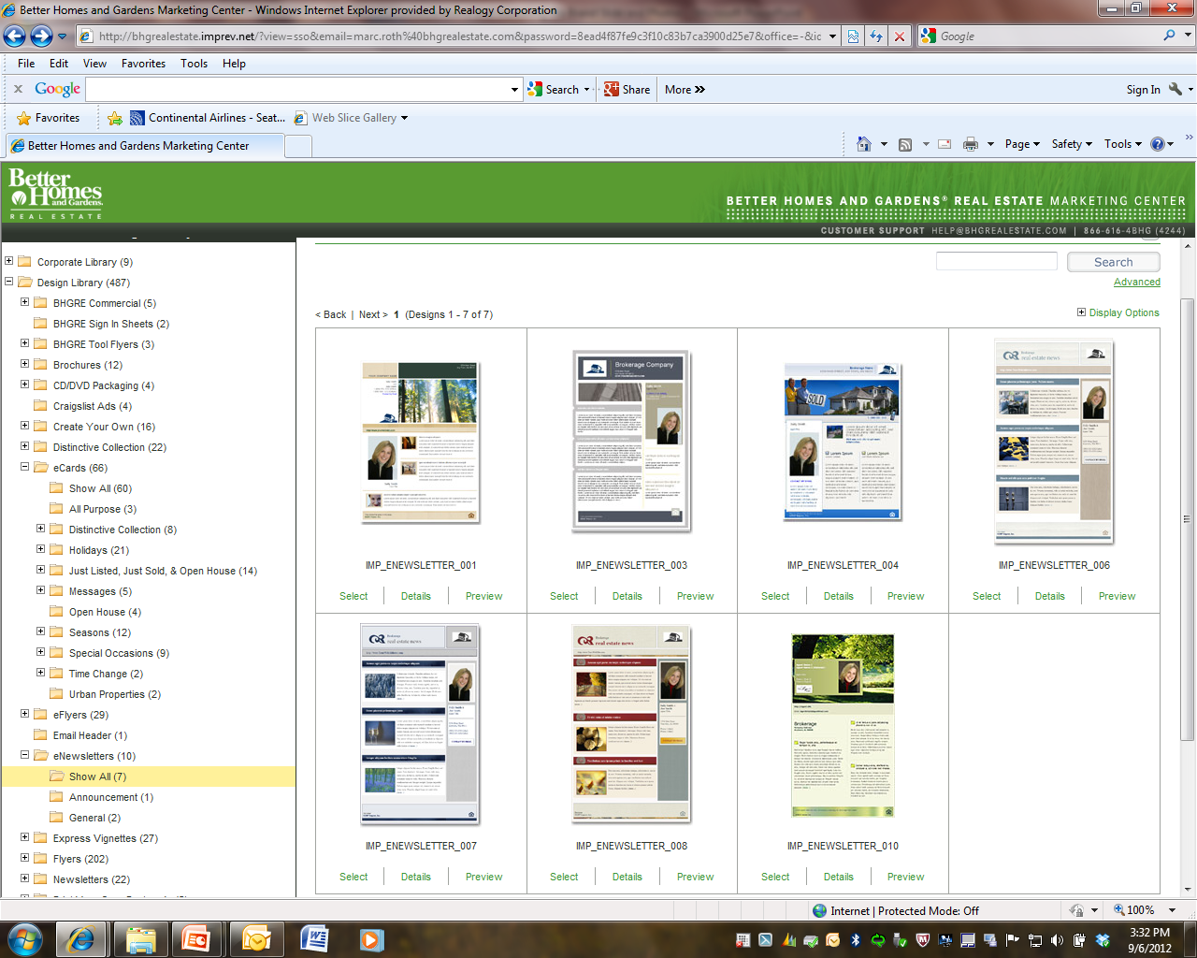
Marketing Plan Options: Mix it Up!
Phone calls
In-person calls
Mail
Email
Social Media
Gifts
Newsletters
Promotions
Notes:
Student handout and facilitator materials page 12
Here are some other great marketing plan pieces and do mix it up. Don’t always do one…people are all attracted to different things, the working mom you can’t catch on the phone may LOVE the emails you send. Also, try to measure the results, see what parts of your marketing are harnessing strong returns. Understand your business. Some things will be harder to measure than others…but, give it your best shot!! I would say for prospecting new clients, you’d want to be bringing them in from at LEAST 5 different touch points, as we never know what the future holds. We have Do Not Call lists, when a lot of people did everything over the phone…..we have anti-spam legislation, who knows what may come down next. It’s interesting, consumers keep getting surrounded by walls of “anti communication”…. When they need more value and education now than ever before…..moral of story is, don’t put all your eggs in one basket.

Slide 19
Basic Marketing Plan: Offline Components
Personal brochure, magazines
Personalized presentations, marketing pieces
Snail mail options
Just Listed/Just Sold, etc.
Personalized informational handouts
Greenhouse
HouseLogic, NAR, area vendors
Tools for creating listing, open house, and other fliers
MARCH 2011
Notes:
Student handout and facilitator materials page 13
For the purposes of marketing we recommend your mix does include both offline and online intiatives.
Some of your offline touches may be: (read above)
Now some of these may be longer term strategies, some can be shorter…keep your budget in mind. As you business starts to flourish and you start getting systems in place, you may want to step back and start investing into your marketing plan.

Slide 20
Basic Marketing Plan: Online Components
Personal website with IDX
Better Homes and Gardens ® Real Estate CRM Tool
Email marketing (e-Cards/e-Newsletters) templates, and
Social share templates/samples
Market reports
Learn how to create a one-page market snapshot from your MLS, or
Use another service to achieve this result – Altos, Top Producer, Realtor Property Resource (RPR) etc.
Notes:
To compliment your offline strategies, you will want to also incorporate some online components. Remember, people search for realtors using different platforms…..they need to see you whenever they turn around. So be wherever your clients go!
Some great ways to reach clients with your message online are: personal website with IDX. (IDX feeds meaning that you will carry all of our local MLS listings on your site. Obviously there is a great benefit to this in that even when you are carrying no listings, your site will show everything else)
The BHGRE CRM Tool, we have an incredibly robust Marketing and CRM tool. We sure to leverage this CRM, it provides you with the type of content that many agents pay a premium to access each month. As you gather your 50 names per month, you will want to get them into the CRM. I won’t get into the details of how it works…..but, be sure that you learn how to use this powerful tool. You can set up a year’s worth of email campaigning in one sit down session. Check out the live training Amy provides you, as well as the pre-recorded classes available in the Be Better University. For our Canadian friends, if you have missed any of the Greenhouse training sessions, let me know and I can forward you any necessary links.
MARKET REPORTS. I am absolutely in LOVE with market reports. (I understand this may well make me the biggest nerd EVER) Market reports themselves are Golden; but, learning how to inpret and communicate them is priceless. I would recommend that you leverage these in EVERYTHING you do, from CMAs (competitive market analysis) to marketing pieces, to listing and buyer presentations……market reports are your “proof” that you know what your talking about when it comes to the market. If you study, understand and communicate these reports, you will be the consummate professional. One thing each of you should keep in mind as your career progresses, is that the real value that you provide consumers is in your ability to “tell them things that they don’t already know”. If we merely tell consumers things they already know, we really have no value to them…….Do be afraid to showcase your knowledge when ever you can. So as we mention, learn how to create market snapshots to send out and if your board isn’t great at providing all the information that you need, you can use an outside service as mentionned above.

Slide 21
Basic Marketing Plan: Online Components
Profile on Realtor.com, Trulia.com, Zillow.com
Plan of attack for social media
What sites will you use? Why?
Email Marketing with PinPoint
Notes:
Be sure that you have your profile full and complete on Realtor.com, Trulia.com and Zillow. For our Canadian counterparts, you have realtor.ca so on the bright side, just one place to go!
It’s important to create a plan of attack for social media!! Let me ask you…..how many people think that social media is a fad? Oddly enough I was in a seminar about 10 years ago and the speaker asked us that question….back then about 50% of hands went up. I think we can agree that social media is not a fad, it just keep growing and evolving and we need to be there with it!
When plotting your attack, the first thing you want to figure out is what sites will you leverage? Be sure you fish where the fish are. Know your consumers, if you don’t know where your consumers spend time online….just ask! People generally enjoy having a part in helping others out. Be strategic about “why” you use the sites you use. When it comes to marketing…..”spraying and praying” doesn’t always work. You need to craft your message and know where to promote it, to get the most “bang for your buck”. For example: linking your blog of best children’s names ever, may create a great buzz on a Platform like Facebook; but, may not resonate the same way on Linkedin. Make sense?
Now….I’m going to introduce you to a tool I’m incredibly envious about…PinPoint. So, for my Canadian collegues, you can grab a quick drink right now if you wish as I’m going to talk a little bit about pinpoint. Unfortunately in Canada, we don’t have access to PinPoint and it is something that really sets our brand apart from any other brand.
PinPoint is a tool that allows you to access the multitude of contacts within Meredith’s database of subscribers – one of the most powerful national consumer databases – to send targeted marketing. Through PinPoint, you’re able to design customized postcards and then mail them to targeted buyers and sellers that are more likely to be in the market to buy or sell a home. The 85 million person PinPoint database is overlaid with demographic, geographic and behavioral data points that allow you to “touch the people who count, rather than counting the people you touch.” This will make any marketing initiatives you plan, the most effective plan in the industry. It also can provide you with a database to send correspondance when you have not yet built a personal database!

Slide 22
Marketing Plan Principles
Frequency is more important than reach
Repetition is king
Use more frequent communication at the beginning of the relationship
What you do isn’t nearly as important as that you do it!
Notes:
Student handout and facilitator materials page 13
If we turn to page 13 in your workbook, we’ve laid out some very important marketing plan principles.
Frequency over reach…….very true, like we mentioned on the last slide, don’t “spray and pray” . If you have a limited budget……it’s better to invest it in a small number of people whom you can touch regularly, than to blow your budget on an incentive that might allow you to reach a thousand prospects but only once or twice a year.
Repetition is always the king, it everything. Repetition is important for a few reasons:
1 Customers like to know what to expect when decisions. When a company chooses a brand message and repeats it across channels, it builds trust as people recognize that they can rely on the business to keep its word.
It helps to gain attention. To get a prospect excited about a concept, a business has to get in his or her head. This isn’t achieved by simply relaying a marketing message once. You must convey the message repeatedly to trigger a reaction. For example, if a clothing store sent you one email about an upcoming sale, you may glance at it; however, if it sends multiple messages, you won’t be able to miss the fact that the store is having sale. This repetition of the messages can create a buildup and may actually excite you to shop at the event.
It will increase your credibility. Highly visible companies often seem more credible to a customer than those he or she has never heard of or knows very little about. When a business repeats the same message on everything associated with its brand, people start to believe it’s true.
More frequent in the beginning…absolutely, it’s hard to impress your brand into someone’s name, so in the beginning you should ensure your consumers see your name frequently, once we get it tatooed in their brains, we can easily communicate messages less frequently without risk of being forgotten.
I love the last point, as it’s true……most agents don’t fail by doing things “wrong”, they fail by not doing anything at all.

Slide 23
Your Technology Plan
Part of your business plan
Why create it?
So you can create a system and process
To move faster and more efficiently
To plan your budget
Report progress prior to sessions 3, 5 or 7
Notes:
Along with your marketing plan, you will want to create a solid technology plan. In fact, the two will often work hand in hand.
In today’s age, you really can’t avoid a technology plan, use of technology is a basic expectation that consumers will have of you.
There is no question that technology can streamline your business in ways people who have been in the industry for decades couldn’t have ever imagined!
As you can on the slide, we have given you some great reasons why you need to create a tech plan…from having an actual system to increased efficiencies and of course to keep your budget under control.
But even on top of that…..the best reason to have a solid tech plan, is to make more money!!!
Research shows that high-earning agents invest more in technology than their low- and medium-income peers. In a survey by Inman News, for instance, 50 percent of agents with annual earnings over $100,000 said they spent more than $2,500 out of pocket on technology each year, while 25 percent spent $5,000 or more. This coorelation isn’t just about the money, it is about the commitment to the tech plan, but, a solid plan can make you more money if you are strategic!!

Slide 24
Tools in your Technology Plan
Laptop
Smartphone
Electronic signature software
CRM
System for market reports
MLS, Altos Research, Realtor Property Resource
Online storage and back-up services
Your company may provide:
Forms software
Presentations and tool for creation (Toolkit CMA)
Basic email and website/profile
Appointment Center
Lead Router
Notes:
Student handout and facilitator materials page 14
This can be found on page 14 of your workbook…..it’s a great checklist of tools you want to have in your Tech Plan arsenal.
So here for a quick poll……who here uses: a laptop, smartphone, electronic signature, CRM sys of market reports.
Fortunately, being with BHGRE….many of your have companies that may provide additional materials such (see above).

Slide 25
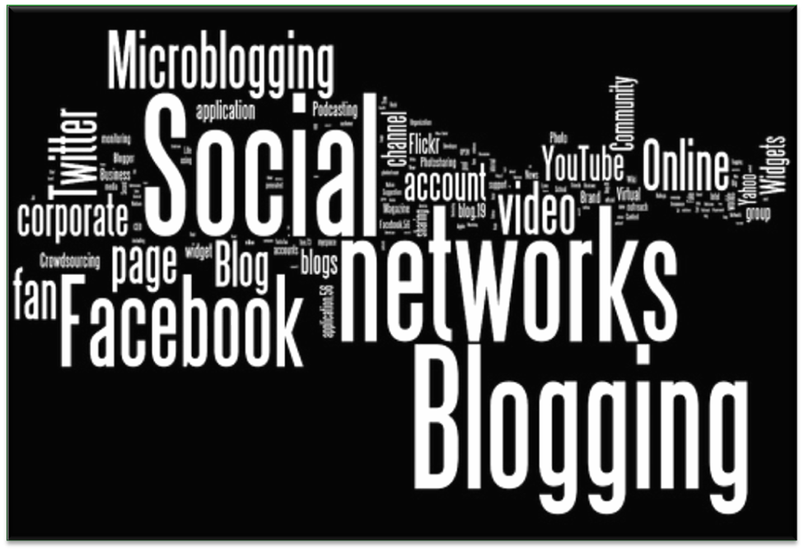
Social Media and Your Business
Another form of communication; part of marketing
Share, collaborate, connect
Will keep evolving
Choose the appropriate method for your client
Notes:
Student handout and facilitator materials page 15
In addition to the tools of your tech plan…..your plan must include an actual Social Media Plan. Social media has actually become an expectation of consumers in today’s market place. Fortunately, you can do some pretty incredibly social media messaging with minimal investment!
Social media helps your messaging to be “seen”, pretty much any where in the world. You can share….collaborate and connect with so many prospects from so many walks of life! All from your desk/seat/car. It’s a great way to “touch” people without being evasive or making clients feel violated. And it is consistently evolving and will continue to do so. Fortunately you are with a brand like Better Homes and Gardens Real Estate, who is the front runners when it comes to social media. No other brand puts the time, research and effort into this media platform like we do…..so leverage it, use our posts, blogs, videos to enhance yourself and your brand.

Slide 26
Considerations Before You Begin
My privacy and personal standards
REALTOR® Code of Ethics (if applicable)
My brand’s advertising rules
My Office/Manager’s Internet policy
Notes:
Student handout and facilitator materials page 15
In your student handout, we list some of the considerations you need to make before you begin your social plan.
Your privacy and personal standards….we understand, when we go social….we are putting ourselves “out” there, but, remember don’t feel pressure to make postings that don’t honour your values. You’ll often see Realtors with both personal and business pages because they want to keep some parts of their personal lives private, I totally understand….especially if you have an insanely crazy sibling like my brother who loves to post humiliating photos. How many marshmallows I can fit in my mouth at once…is something I want only my family to know ☺
Of course the Realtor Code of Ethics….if anything is your mind is ever questionable, involve your manager or refer to directly to the Realtor Code of Ethics itself.
Any of our brand’s advertsing rules….being part of a brand has renowned as Better Homes & Gardens, is really an honour and should be treated as such. Meredith has chosen our team as someone they can trust with their BHG brand and we need to protect it….
Without saying, know your office policy and adhere to it…..we would hate to see anybody lose a promising career BHGRE career over a night of drunken stupor.

Slide 27
Set Measurable Goals
What type of followers/fans do you want?
What makes you unique?
Translate that in to your social media profiles
Your message should be consistent across all channels
How much time can you commit to managing your social media?
What results are you hoping to achieve?
Notes:
Student handout and facilitator materials page 16
I hope everyone is really seeing the pattern here that we are trying to help you to make strategic decisions about your business…..no shooting from the hip in this class! The more strategic you are, the better your results!
The first step of any sort of marketing plan is define your target market…knowing the type of followers you want will help you greatly in deciding what type of content to post, what sort of groups to join. Just for an example, if you want to attract young families…….you may not want to have a vast majority of your postings geared to the top retirement homes.
Can anyone on the call define your target audience or if you haven’t “focused” on that yet….is there an audience you’d like to aspire to have? Do you know where to find them? Keeping in mind, we can still sell to anyone we want….but, we want to focus our energies in segments where we will see the greatest returns.
Be sure you can define through your messaging exactly what makes you unique, what do you do better than anyone else in your area…..what will people associate you with
What is something that might make you unique? Now….it’s important in your social media marketing that you are your authentic self….BE who you are, don’t try to be who you are not…..Then ensure your messaging is consistent….this will be easier if you truly embrace your authentic self. If you try to have different messaging in different channels trying to appeal to different people, you will come across as inauthentic and not so trust worthy…..so operate with pure intention.
What results are you hoping to achieve…be sure to define this, if you do not….how in the world will you measure success? So what might be a great social media result? Increase sphere of influence, add 2 sales to your average,

Slide 28
Build Relationships
Don’t just share links
Don’t just rely on market reports
Share your personality; converse with others
Respond to all comments
Notes:
Never forget that social media is about relationships and it is a great forum for that. Has anyone on this call been able to get back in touch with someone that they knew from college or university? How about old sports mates? When you first get back in touch…the minute a long lost friend has connected with you…..how did you feel?
Social media can make people “feel”…. So don’t be cold. Don’t be guilty of just sharing links, don’t just rely on real estate reports…..make friends. Think of social media as a social party on an incredibly large scale. Would it surprise anyone to know that more often than not people who are great at networking at parties are also great networkers online? In today’s world, you can forge great friendships and clients in ways that people in the industry even 10 years ago were just starting to realize. It is the best place to showcase who you are, not just what you sell.
Absolutely respond to all comments......imagine you are at a self development event (please excuse me, if I get a little passionate here…because it happened to me) or any event…concert, poetry reading..anything. Something you see or hear, moves you enough to want to tell the speaker/musician/poet how what they just said, may actually change your life. You approach said speaker/musician/poet….excited, knowing this is going to be the best moment EVER…..and you get to this person give every one of your thoughts and they listen to every word and turn and walk away. No thank you, no I’m glad I could help, no smile……..feel that feeling of anger, regret, complete disenchantment. Well that’s how people feel whenever their comments go unnoticed. Not responding to comments online, is like turning around and walking away. Don’t make people feel like that, it will never serve your business well. I understand we may not bat 1000 here….but, try. The person who responds will create an advocate.

Slide 29
The How, Why, and What of Social Media
Set measureable goals
Start listening
Build relationships
Share interesting content
Get out and engage
Get local
Notes:
Okay….so here is the moment where we hit you in the head to make sure you were paying attention and to stress our points!!
So we will all: (read above) Now I didn’t mention about getting local earlier, but, I’m hoping each of you understand the importance of that. I need to focus my messaging on what’s going on in my local market……remember people who are searching to live in your area are not doing internet searches on their current “city”…they are seeking info you’re your area….be the local expert, being the state expert (especially somewhere the size of CA) is going to be very confusing for people…..pick your LOCALE!

Slide 30
Create Conversation
It’s more important to converse with others than to simply post listings. Your content should consist of:
20% linking to your content
Market stats, neighborhood photos and videos, real estate FAQ’s
20% linking to other people’s content
Local sports team, restaurant, school district, government office, local blogger, reciprocal linking, etc.
20% other business talk
Industry news, brand updates
40% personal talk and networking
Ask about followers’ animals/kids - people love it just as they do offline
Notes:
Student handout and facilitator materials page 17
So let’s go over page 17 notes. Like we said social media is like a social gathering…..don’t be “that guy or girl” who stands up at the party and starts telling everyone about yourself, the one who even when someone tries to converse doesn’t miss a beat and continues his/her own promotion. I know you have all seen someone like that….and I know when you see it, under your breath you say things we can’t even say or even THINK on this webinar. Social media is not different….there will be plenty of opportunities to inject your knowledge, your message, but you need to allow others their time as well.
We recommend the above breakdown. 20% your content….you can show value through your knowledge…absolutely. We’re not saying only listen…..but keep it to 20% 20% links…I love that…promote others, especially is they have great and valuable content. Why recreate the wheel AND you can make a great strategic alliance in the meantime!!
20% other business……show you have multi facets. Be knowledgeable of the economy and business outside of real estate…..people don’t only want to hear about real estate, they crave knowledge about their communities, new products…anything. Knowledge is power…. And 40% personal talk and networking…40%...does that percentage surprise anyone? This is perhaps one of the easiest things to do and you will put humongous deposits into people’s emotional bank account. Human beings (and our clients are human beings)…human beings for the most part are ego driven…..I don’t care how enlightened someone may appear to be, we all appreciate being acknowledged. Okay….I have a quick question here……for all the Facebook users (and please be honest, no judgement) how many of you when you first login look at the “me” notifier? Regardless of how selfless we may be….. Why do we do that? It makes us feel good…when we see someone like our pictures, respond to our comments….it feels GREAT, it can turn a bad day around!! My best friends, there was a time I really didn’t like her…then she liked a picture of my daughter and commented cutie. I was so happy, she is now my BEST friend…. Other people feel the exact same way when you acknowledge them. Just something as simple as, “I love your new haircut” will make you a hero for a moment….but, remember again….we are working with humans…..even if you imprint positively for just a moment in someone’s consciousness you will imprint permantently in their subconscious and you want to own everyone’s subconscious……that’s when your name will start rollling of the tongues and you will create advocacy.

Slide 31
Detailed Information
Your pages 18-21 have detailed information on how to set goals and strategies for
Facebook
LinkedIn
Twitter
Blogging
Notes:
Student handout and facilitator materials page18
As we discussed earlier, there is so much content in this course, we will do as much as we can on these calls; but, some of it you can work through in the workbooks. Pages 18-21 will have more detailed information that will greatly assist you with your social media plan/strategy.

Slide 32
Social Media Planner
Daily Activities | Mon | Tues | Wed | Thurs | Fri | Sat | Sun
Post meaningful content
Engage 3 people you already know
Make 3 relevant comments/responses
Reach out to 3 new people
Video resource: Profitable Prospecting
Notes:
Student handout and facilitator materials page 20
This is a great tool to use to help you plan your social media and like the forms we did last week….you can do this once and keep it with you…..this will keep you focused on what you need to do each week, this doesn’t have to change. A simple checkmark under each completed task each day will keep you on target. I absolutely love this “top of mind tips”.
I have a question…….what is everyone doing with their workbooks? How are you using your forms? Where do you keep them? What do you do with them?
Learn from one another!!

Slide 33
What You’ve Already Accomplished
Prioritized your start-up plan (business producing and business supporting)
Created an effective prioritized weekly schedule
Understood the Sales Path concept for time management
Learned a Lead Generating Plan
Started your Follow-Up: Make Money from ‘Leads’ with Consistency
Notes:
Student handout and facilitator materials page 22
Okay…..so, let’s take a peek at all of our successes!!! Very exciting moment!!
We have officially: (read above)

Slide 34
What You’ve Already Accomplished
Able to craft a sales call to your best source of business to assure a ‘lead’
Able to circle prospect
Created a marketing plan utilizing the resources in the Greenhouse
Created a technology plan
Learned how to attach benefits to features
Notes:
Student handout and facilitator materials page 22
In addition we have also learned to……
Wow, I was going to try to be cute and read it all with one breath….then I realized it was two pages.

Slide 35
Recommended Actions to Take Right Now
Complete your Recommended Action Plan Checklist
Do the efficiency tracker due prior to next week’s session
Do your marketing and technology plans
Start using Follow Up: From Leads to Clients
Add another 50 people to your database
Notes:
Student handout and facilitator materials page 22
Ok….now is the time we assign homework….no groaning allowed!
Don’t forget to add another 50 people to your database! By the end of this week, you should be at 100!!

Slide 36
Recommended Actions to Take Right Now
Practice your lead generating dialogues:
Craft a sales call
Circle prospect
Watch the listed videos available
-> Greenhouse -> Learning -> eLearning Videos
-> Resource Videos -> Seeds of Success
Notes:
Student handout and facilitator materials page 22
So we are leaving you LOTS to do by next week….you may find this a little more fun then last week though as we’re starting engage actual consumers!! For energy sharers like me, this is our “thing”.

