Slide 1
Seeds of Success
The Listing Process: A Professional Approach
Session Seven

Slide 2
Goals of This Session At the end of this session, you’ll have the tools to:
Use the professional listing system to assemble your listing materials
Ask critical qualifying questions to potential sellers to save you time and create results fasters
Explain to sellers how you work to raise trust/confidence
Use personal standards evaluator tool to determine which sellers are qualified to work with you
Organize a listing presentation
Create a marketing plan to use with sellers
Craft an ‘objection buster’ to answer common seller objections
Notes:
Student handout and facilitator materials page 1

Slide 3
Resources for Session Seven
Materials available at http://bit.ly/seedsofsuccess
Evaluating Property Salability
22-Point Marketing Plan
Pre-qualifying Questions for Sellers
Questionnaire for Sellers
Your BHGRE Listing Presentation
Notes:
Student handout and facilitator materials page 2
Mention Action Plan checklist

Slide 4
Resources for Session Seven
Videos available in the Greenhouse>Learning>Be Better University>Resources>Video Resources>Seeds of Success
Qualifying Sellers
Proper Pricing
Craft an Objection-Buster
CMA Software
Notes:
Student handout and facilitator materials page 2
Mention Action Plan checklist

Slide 5
Create Your Listing System
Check | What | How | Materials to Use
 | Pre-qualify seller | On phone/in person | Pre-qualifying questions*
 | Set appointment
 | Qualify seller/educate | At home | Qualify Seller Questionnaire* Explain how you work
 | Make 2ndnd appointment
 | Evaluate your chance of success Do research
 | Prepare marketing presentation with plan & CMA/market trends |  | Anticipate objections with visuals Company materials Market trends
 | Present marketing plan (what you’ll do & CMA) | At home with all decision-makers | B H and G listing presentation** 22 Point Marketing Plan*
 | List property |  | Listing agreement
 | Market property | With your marketing plan Communicate with seller | 22 Point Marketing plan Internal marketing checklist*
√
Notes:
Student handout and facilitator materials page 3
Explain there are 3 big steps:
Put a 1 By Pre-qualifying
Put a 2 by Qualifying
Put a 3 by Presenting marketing plan
Chat: What % of agents have a listing system?

Slide 6
The Qualifying Process: Pre-Qualify First
Qualify first!
Notes:
Student handout and facilitator materials page 4

Slide 7
Pre-Qualifying Questions Why Ask?
To find out:
Why you wouldn’t proceed (standards)
Positives about listing the property (cause you to go ahead)
What’s your dialogue for explaining to the seller your reason for asking these questions?
Notes:
Chat: Question—what’s in it for sellers to meet with you?

Slide 8
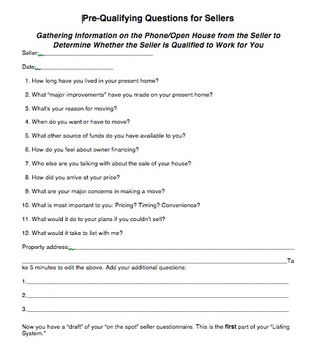
Pre-Qualifying Questions
Gather information on the phone or in open house to determine whether the seller is qualified to work with you
This document is available to you
Notes:
Student handout and facilitator materials page 8

Slide 9
If Sellers are ‘Underwater’
Questions:
Has making payments on your home become a burden to you?
If ‘yes’: “Are you current on your payments?”
If ‘no’: “Have you discussed options with anyone?”
You can suggest contacting your Department of Licensing for helpful information (have links available for them); talk to an attorney who specializes in equity-short situations; refer them to a trusted short sale team
Notes:
Student handout and facilitator materials page 8
Can go into formal qualifying appointment—add to the seller questionnaire

Slide 10
If Sellers are ‘Underwater’
Questions:
How much equity to you believe you have?
How many loans do you have?
Do you have any hardships that would influence your ability to make your payments?
Leverage with the bank to do a short sale
Notes:
Student handout and facilitator materials page 8
Can go into formal qualifying appointment—add to the seller questionnaire

Slide 11
Check | What | How | Materials to Use
 | Pre-qualify seller | On phone/in person | Pre-qualifying questions*
 | Set appointment
 | Qualify seller/educate | At home | Qualify Seller Questionnaire* Explain how you work
 | Make 2ndnd appointment
 | Evaluate your chance of success Do research
 | Prepare marketing presentation with plan & CMA/market trends |  | Anticipate objections with visuals Company materials Market trends
 | Present marketing plan (what you’ll do & CMA) | At home with all decision-makers | B H and G listing presentation** 22 Point Marketing Plan*
 | List property |  | Listing agreement
 | Market property | With your marketing plan Communicate with seller | 22 Point Marketing plan Internal marketing checklist*
√
Create Your Listing System
Notes:
Step 2 Qualifying

Slide 12
At the Seller’s Home: Gathering Information
Gather critical information
Save time
Prove your professionalism
Uncover hidden motives
Use information later to narrow home choices and close
Demonstrates how you would work/ what you’ll do for them
When? Prior to inspecting the home

Slide 13
Qualifying: The Seller’s Questionnaire
Explain what’s in it for them to meet with you (qualifying appointment?)
Introduce the interview process/explain ‘why’
Ask questions first, preview the home second
Sit in a comfortable place (kitchen table?)
What is the seller looking for from you?
Bottom line: Create trust, rapport, and set the stage for the listing relationship
Notes:
Talk about seating
Explain process: 1. ask questions
2. See the home
Why?

Slide 14
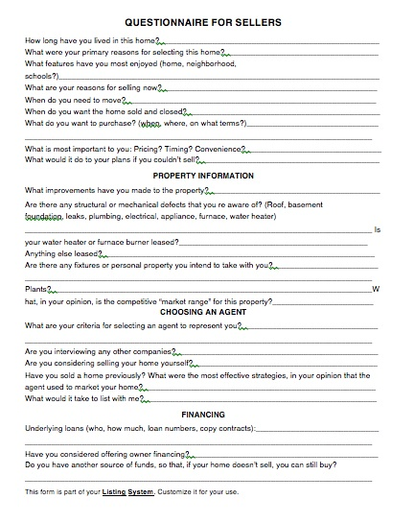
Qualifying: The Seller Questionnaire
This questionnaire is available to you
Lifestyle needs
Preferences
Function of need or feature
What they don’t want
Hidden motivators
Agent experiences
Financial needs
Timeframe
Barriers
Watch the video: Qualifying sellers available on the Greenhouse
Notes:
Chat: What questions to find hidden motivators?
Barriers?
Caveat: DON”T give your listing presentation or counter objections; just gather information

Slide 15
Before You List: Evaluate the Seller and the Property
What 5 standards or guidelines would you need in place to list the property?
What seller answers would cause you not to list the property?
These are your seller/property standards

Slide 16
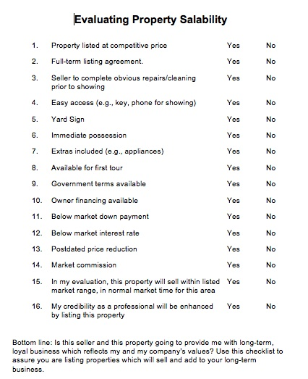
Evaluating Property Salability
This evaluator is available to you

Slide 17
Check | What | How | Materials to Use
 | Pre-qualify seller | On phone/in person | Pre-qualifying questions*
 | Set appointment
 | Qualify seller/educate | At home | Qualify Seller Questionnaire* Explain how you work
 | Make 2ndnd appointment
 | Evaluate your chance of success Do research
 | Prepare marketing presentation with plan & CMA/market trends |  | Anticipate objections with visuals Company materials Market trends
 | Present marketing plan (what you’ll do & CMA) | At home with all decision-makers | B H and G listing presentation** 22 Point Marketing Plan*
 | List property |  | Listing agreement
 | Market property | With your marketing plan Communicate with seller | 22 Point Marketing plan Internal marketing checklist*
Create Your Listing System

Slide 18
Explain How You Work*
*If you have decided you don’t want to list the property and work with the sellers, do not go to this step!
Your professional standards, and why
What you will list- and what you won’t list, and why
What you will provide (mention the 22-point marketing plan)
How you will be accountable
Walk through the home and take notes
This is the end of the information-gathering/questions
Now do the listing presentation (if you decided to go ahead)
Notes:
Importance

Slide 19
Check | What | How | Materials to Use
 | Pre-qualify seller | On phone/in person | Pre-qualifying questions*
 | Set appointment
 | Qualify seller/educate | At home | Qualify Seller Questionnaire* Explain how you work
 | Make 2ndnd appointment
 | Evaluate your chance of success Do research
 | Prepare marketing presentation with plan & CMA/market trends |  | Anticipate objections with visuals Company materials Market trends
 | Present marketing plan (what you’ll do & CMA) | At home with all decision-makers | B H and G listing presentation** 22 Point Marketing Plan*
 | List property |  | Listing agreement
 | Market property | With your marketing plan Communicate with seller | 22 Point Marketing plan Internal marketing checklist*
√
√
√
Create Your Listing System
√
√
Notes:
Step 3

Slide 20
Presenting Your Listing Presentation
Greenhouse → Marketing →Presentations
Use the Better Homes and Gardens® Listing Presentation
When?
After qualifying (them and the home)
After telling how you work
Notes:
In their transcript--new

Slide 21
Choose Strategies – Make a Marketing Plan
In writing
Given to seller
What you’ll do
When you’ll do it
Explain how you will report with it.
The customer doesn’t know what he’s getting… until he doesn’t
This document is available to you.
Notes:
Chat: Why put it in writing?
Mention Practicum
Should be at 1 hour into webinar

Slide 22
Your Marketing Choices
Customize your 22-point marketing plan.
Customize your 22-point marketing plan
Digital marketing center
Printed postcards
eCards
Social media
PinPoint for targeted mailing campaigns

Slide 23
New Sales Skill: Handling Objections
Important to do right
Moves the sales process forward
Poor handling (or non) stops the process
Gives you confidence
Helps sellers and buyers clarify real concerns
Discovered during your qualifying and listing presentation
Notes:
Pages 17-18 list common listing objections.

Slide 24
Building Your Sales Skills
Use the AAA Method
A Agree
A Ask
A Answer
Avoids arguments, confrontations
Gives you time to think of an answer

Slide 25
Objection Buster Example
Seller: “I want to wait to sell.” (objection)
A You agree: “I can understand your concern. Selling is a big decision.”
A You ask: “So I can understand exactly what you’re thinking a out, do you mind if I ask you a few questions?”
You probe and ask more: “Tell me about ‘wait to sell’”.
A You answer: “There’s some information that could help you make the best decision. Let me show you…” “Do you have any questions? Let’s go ahead.”
Notes:
Do one now
Go back to pages 17-18—list of objections; check 5 to work on this week.
Add visuals

Slide 26
Objection Buster Worksheet
A You agree
A You ask __________
More probing questions:
Tell me more ___________
Please explain __________
Then what happened ____
How, what, when, why, how much …..
A You answer (use visuals*)
Notes:
Do one now – p. 20 workbook
Go back to pages 17-18—list of objections; check 5 to work on this week.
Add visuals

Slide 27
Check | What | How | Materials to Use
 | Pre-qualify seller | On phone/in person | Pre-qualifying questions*
 | Set appointment
 | Qualify seller/educate | At home | Qualify Seller Questionnaire* Explain how you work
 | Make 2ndnd appointment
 | Evaluate your chance of success Do research
 | Prepare marketing presentation with plan & CMA/market trends |  | Anticipate objections with visuals Company materials Market trends
 | Present marketing plan (what you’ll do & CMA) | At home with all decision-makers | B H and G listing presentation** 22 Point Marketing Plan*
 | List property |  | Listing agreement
 | Market property | With your marketing plan Communicate with seller | 22 Point Marketing plan Internal marketing checklist*
Create Your Listing System
√
Notes:
CMA—the pricing part of the presentation

Slide 28
Your Comparative Market Analysis
Fair Market Value:
“The highest price in terms of money that a property will bring in a competitive and open market under all conditions requisite to a fair sale, the buyer and seller each acting prudently, knowledgeably and assuming the price is not by undue stimulus.”
Define a range of value

Slide 29
Completing and Presenting Your CMA
Move from the ‘big picture’ of the market to the specifics’
Educate the seller as you explain the ‘why’ of your pricing strategy
Show proof of your claims

Slide 30
The Process of your CMA
Explain the state of the market— buyer/seller/ transitioning
Show market statistics
Number of homes available in the price range that the seller is competing with: _____________
Number of buyers who bought in that price range within a period of time: (supply vs. demand): ________
Time on market for sold homes: __________
Notes:
Show

Slide 31
The Process of your CMA
Movement of the market in general
Time on market for pending listings
Expired (price range that determines a home will expire; significance of expired listings)
Sold
Market supply in general

Slide 32
The Process of your CMA
The home’s competitors
On market
Pending sales
Sold properties/Time on market for sold properties
Expired listings /significance to seller
Market supply

Slide 33
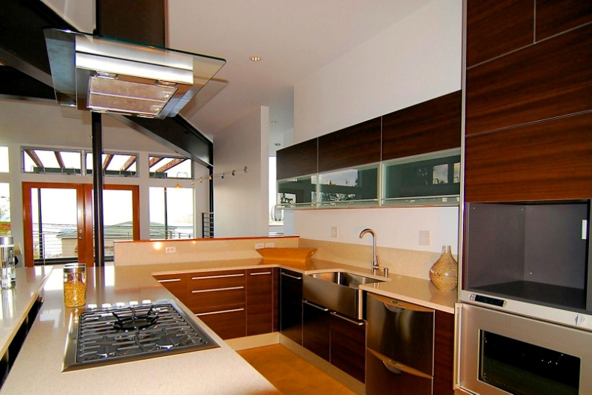
4. Positioning the Home Competitively
Show homes that best compete with yours—and why
Explain positioning necessary to sell the home to the best buyer
Educate--what happens when the home isn’t positioned properly and languishes on the market
Examples: Home didn’t sell/DOM/price
Your goal: Show the seller, with generous evidence, why pricing properly is in the seller’s best interest
Software: Toolkit CMA, RPR, MLS
Notes:
Chat: What is some evidence of right-wrong pricing you can show?

Slide 34
What You’ve Accomplished So Far
Looked at the components for a completing listing system
Explored several questions to pre-qualify a seller
Found the importance of using a detailed Seller Questionnaire
Designed a method to determine whether a seller is qualified to work with you
Learned how to present how you work to raise credibility with the seller
Notes:
Closing thoughts
Motivation: statistics on not giving up
Persistence*
48% of salespeople—give up after 1 call
25%--2 calls
12%--3 calls
5%--4 calls
90% total give up
But, 80% of all sales are made AFTER the 5th call!!!!!!!!!
*AT & T at Your Service survey

Slide 35
What You’ve Accomplished So Far
Designed your presentation, using the Better Homes and Gardens listing presentation (including a CMA)
Designed a marketing plan integrating the many marketing tools provided by Better Homes and Gardens® Real Estate in the Greenhouse
Learned how to craft an objection buster

Slide 36
Recommended Actions to Take Right Now
Craft at least 5 seller objection-busters and practice them with another agent
Consider adding a pre-first visit seller’s package
Practice asking seller the questions in the Seller Questionnaire to uncover hidden motives
Practice your ‘how I work’ dialogue
Do a CMA on your own home; present it to a fellow agent and get feedback
Customize your Marketing Presentation
Put together your listing presentation and practice it
Watch the listed videos in the Greenhouse, Learning Tab
Notes:
Next session: Vision and values selling
Lifestyle marketing
Creating value-added services
Handling more seller objections
2 more lead sources: Expired lsitings/internet leads

