Slide 1
Seeds of Success
Holding a Productive Open House
Session Four

Slide 2
Goals of This Session At the end of this session, you’ll have the tools to:
Organize a successful Open House
Ask questions to qualify buyers in an Open House
Get an appointment from an Open House
Handle common objections in Open Houses
Apply a new pro-active lead generating method
Convert for-sale-by-owners to listings

Slide 3
Resources for Session Four
Software:
Open Home Pro on the iPad
Facebook
Instagram
Pinterest
Zillow, Trulia, Realtor.com
Webinar recordings available in The Greenhouse:
Prepping for an Open House Event
Rock Your Open House!
Strategic Open House Follow Up
Target Market and Work with FSBOs
In bit.ly/seedsofuccess:
Three Steps to List the FSBO
Open House Checklist
Qualifying Questions for Open House
Script for Converting the FSBO – Weekly Visit Approach
The Day of the Open House (checklist)

Slide 4
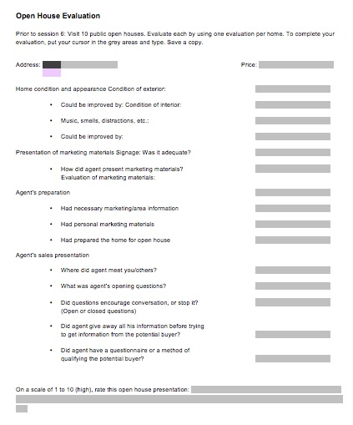
Open House Evaluator
What did you discover?
What will you incorporate into your open house?
What were negative or non-effective actions?
How well-prepared were the agents?

Slide 5
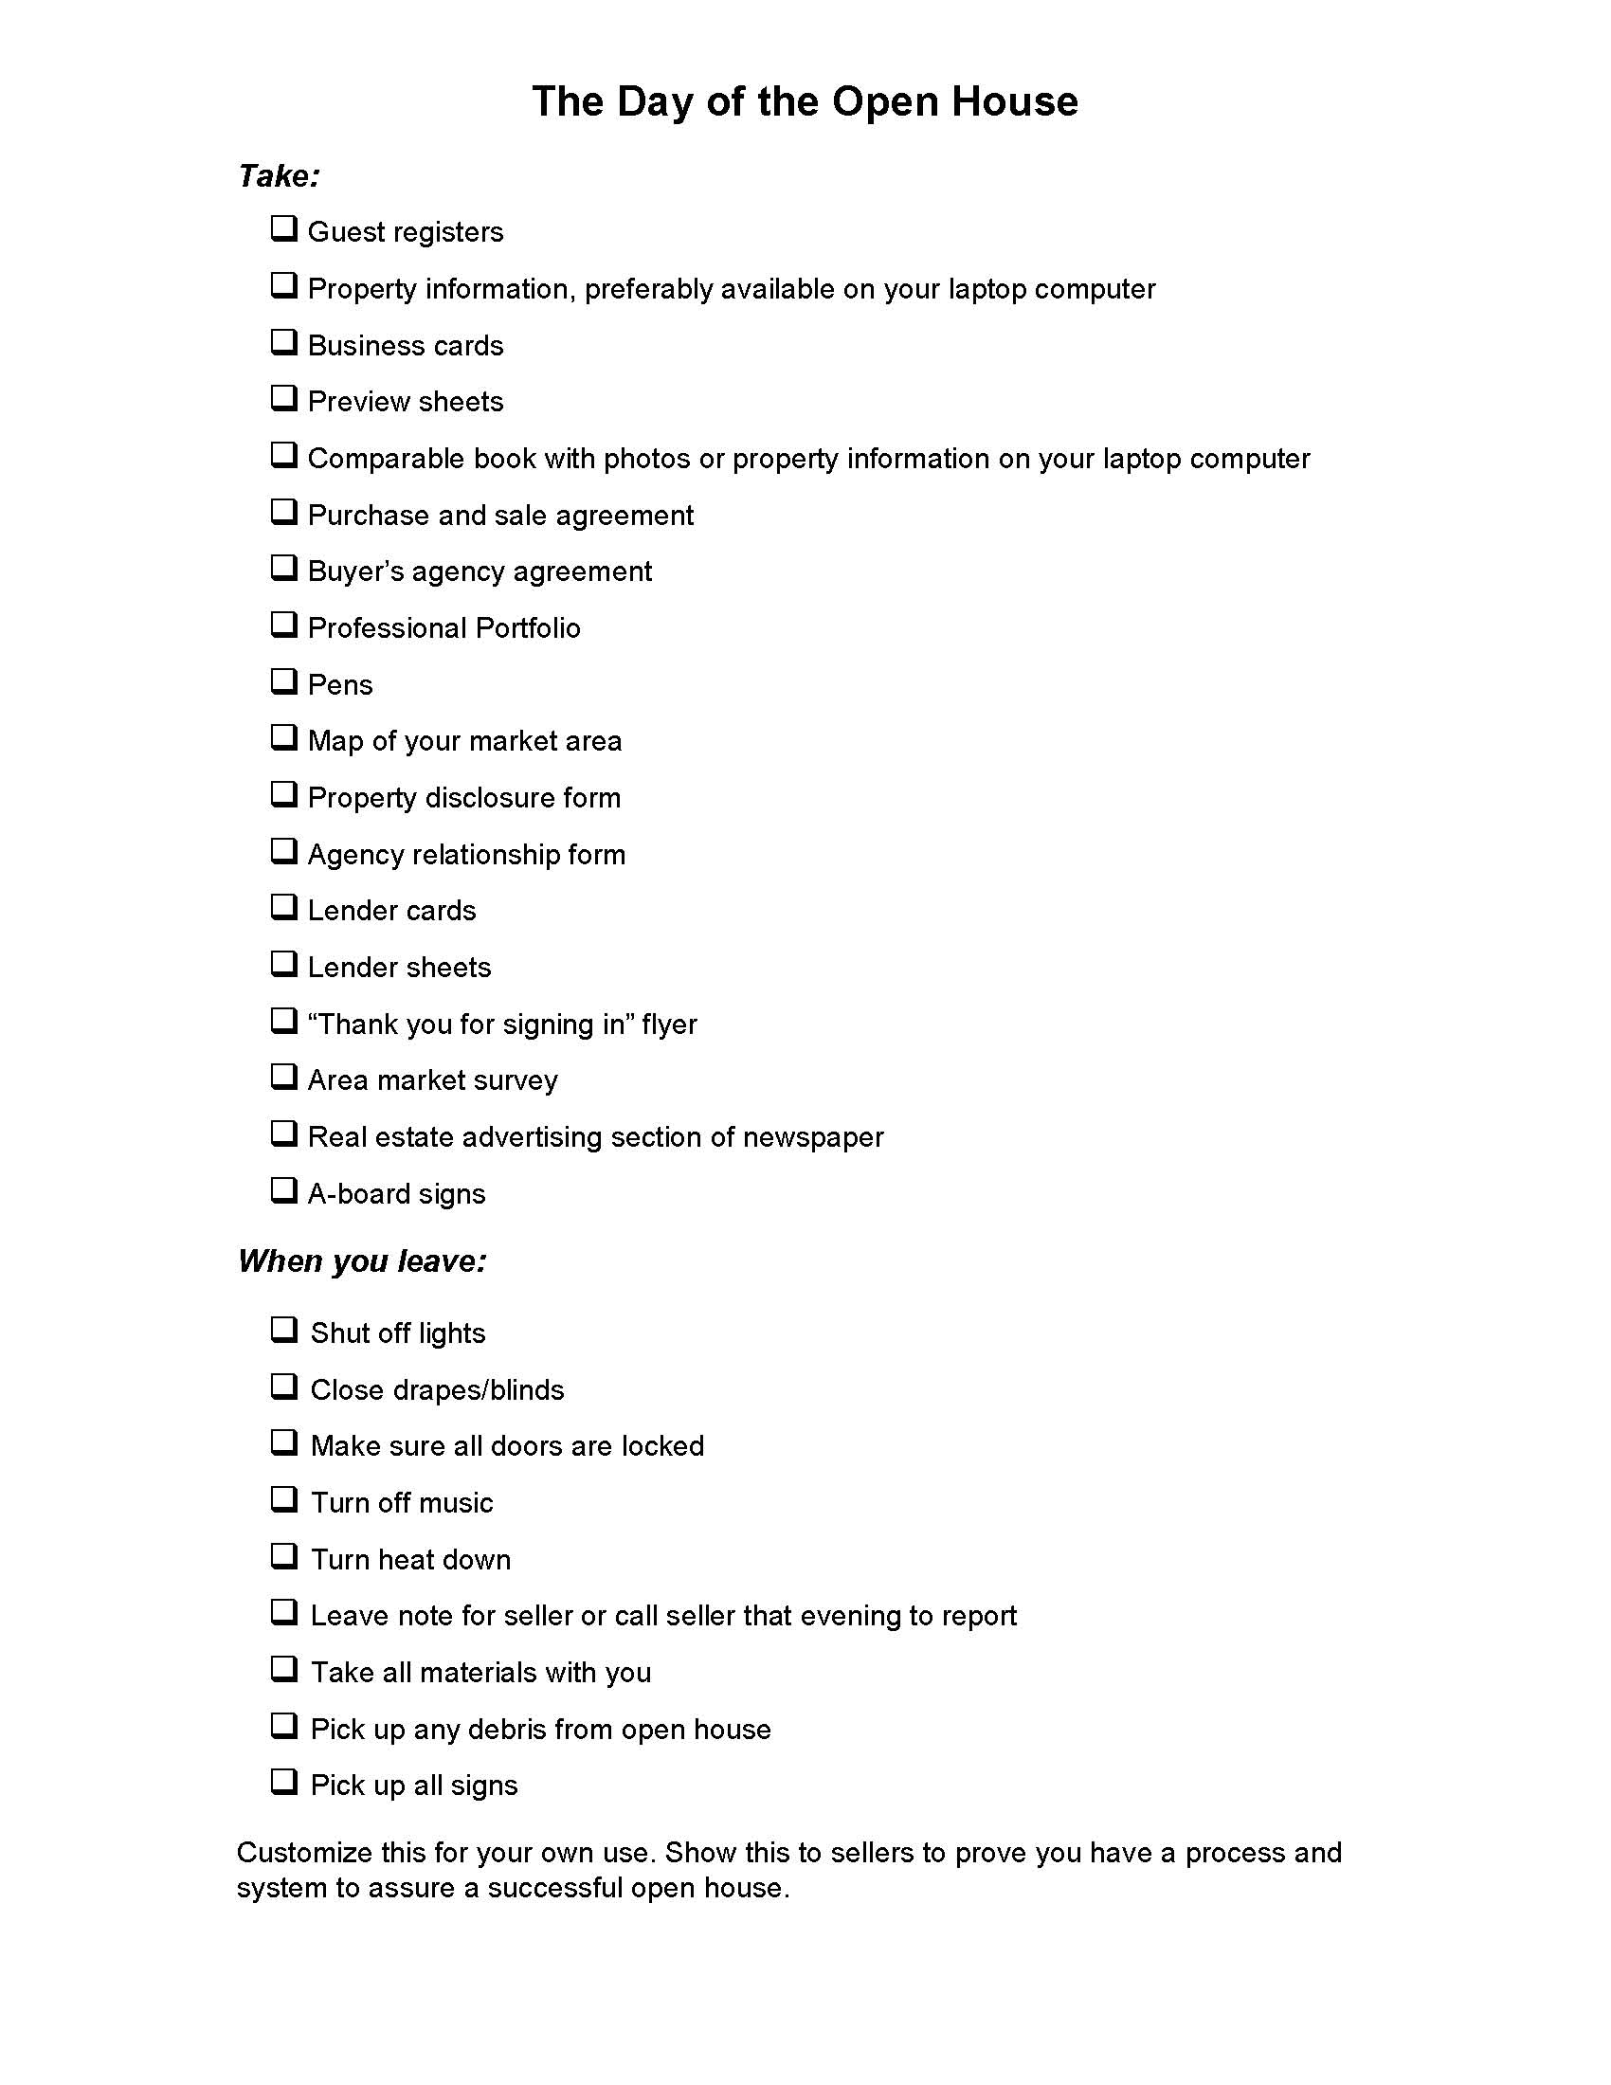
Open House Checklist
Provide blank and completed checklists in your listing presentation*
*Keep proving you keep your promises and are systematic
This checklist is available to you
Tech Tip: Grab the OpenHomePro app for your iPad to allow your open house guests to sign-in on your iPad

Slide 6
The Day of the Open House
Provide blank and completed checklists in your listing presentation*
*Keep proving you keep your promises and are systematic
This checklist is available to you

Slide 7
How to Optimize Your Open House Opportunity
Circle prospect at least 50 homes before this open house
Have a private showing; share MLS statistics
Create a flyer about the open house, with a small biography of you in the lower portion of the flyer
Add a sign rider
Other promotion methods:
Add to syndication sites like Realtor.com, Trulia.com, Zillow.com
Social Media
Email to your clients
Postcards
Phone calls

Slide 8
Principles for an Effective Open House
Proactive or reactive?
Reason to hold open house?
Best kind of property?
What does the public want?
What does the agent want?
Differentiate yourself in the open house?

Slide 9
Open House Process Flow Chart
Qualify: Qualifying Questions
If qualified
Tell/Sell
Make
Appointment
Not Qualified
Cultivate
Video resource: How to Get an Appointment in an Open House

Slide 10
Four Sales Skills for Open House Success
Get their attention in the open house first
Arouse their interest with a question
Ask probing questions to get qualifying information
Close for an appointment

Slide 11
Skill #1: Get their Attention First
Why?
They want to avoid you!
How?
Notice something about them/their car, etc. and give a sincere compliment, or ask a question

Slide 12
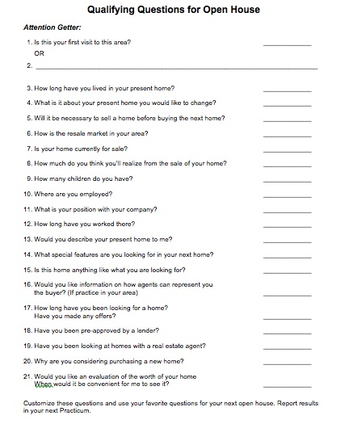
Skill #2: Open House Qualifying Questions
What do you want to find out:
Who?
Needs (buy/sell…)?
When?
Working with an agent?
This document is available to you

Slide 13
Skill #3: Probing
Probing is a method to find out more about a statement
Question: What do you want in a home?
Probe: Tell me more
Please explain
How will that help you?
Point: Keep asking questions about that initial statement until you’re sure you understand the needs of the buyer

Slide 14
Skill #4: Closing for an Appointment
Have you raised their ‘desire’?
What’s your next step?
Appointment to qualify - why?
Something to email/send – what?
BHGRE postcards in the Greenhouse.
Call! Any excuse is fine…
When: Within 1 day

Slide 15
Handling Objections from Your Open House
Common Objections:
I have an agent
Just looking
Just want the flyer
Don’t have time to talk
Not in a hurry

Slide 16
Handling Objections
Use the AAA Method
A Agree
A Ask
A Answer
Practice answering 5 open house objections prior to your next session

Slide 17
Apps/Tech Tools
Open Home Pro (registration)
Walk Score
Around Me
Wikihood
Notes:
Here are a few apps that we recommend you utilize during your open house. You may even want to provide a list of them to your clients if they appear interested.
Open-House Pro…..this can be utilized as a registration tool to capture your leads. You can:
• Manage all walk-ins at weekly open houses or broker opens • Automatically followup with leads using new contact methods that get opened and read more than 2x the industry average • Create beautiful listing pages for all of your properties that buyers can leave feedback on or get in touch with you with one click. • Export any collected data to excel or a CRM like top producer or directly pass the leads to iCloud • Make your own custom questions
Obeo….very cool to use with visitors. If you have professional pictures taken with Obeo (or your own..although may not be as effective), they have an additional tool you can use called: StyleDesigner and it’s very cool. You can, for a minimal fee, take a picture of a room and they will “rework” it in a way that clients can change: wall colours, flooring, cabinet colours. This is great for you to showcase what a room could like more to the personal taste of the visitor. We are currently speaking with Obeo on a National Level to secure a brand promotion for our network.
Survey Monkey…. you can use Survey monkey as a means of sending anonymous surveys to the people who visited your open house. This will not eliminate your need to ask personally at the event; however, sometimes people are more honest and open when anonymous. You may find some crucial information about how a home shows, that you can easily correct.
Community Scout…another great app to showcase to visitors is our very own Community Scout. This is a great way to bring lifestyle in to the conversation with a visitor to again, differentiate you and your brand from others. If they are unfamiliar with the area you can bring it up and discuss with the community demographic, ie: schools, churches, ages, home owners vs renters…it’s amazing. Can you see the depth you will be bringing to your visitors? Are you seeing that both you and BHGRE are different?
Benjamin Moore Colour Capture….With this app, people who find inspiration in your client’s décor can learn to recreate it on their own. By simply hold up a camera/tablet, the app can capture the colour to photograph and suggest the actual name of the colour. If visitors say, “I love the colour of this kitchen”, you can tell them what it is.
c

Slide 18
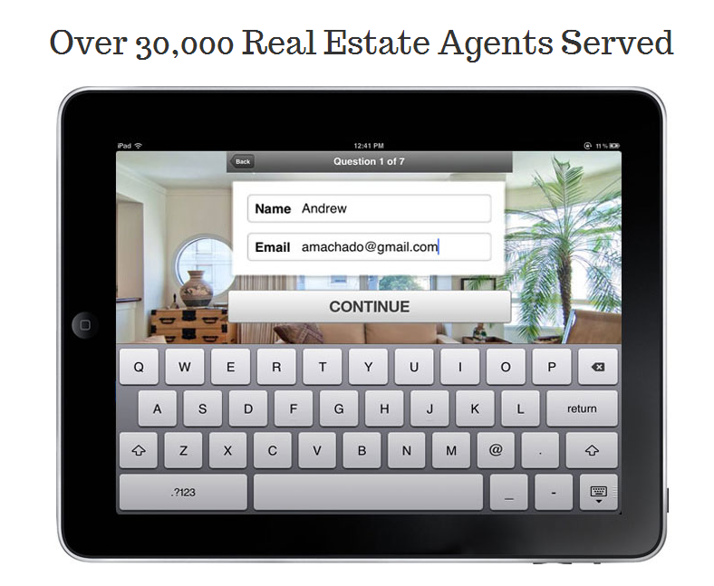
Open Home Pro
Over 30,000 Real Estate professionals served
Notes:
Use Open House Pro to capture registration and simple questions that you would like for the Buyer to answer. You will know quickly if the Buyer is already working with an agent, if they’re pre approved. If you can capture this when the people initially come through the door…you can then walk with them and take notes right in the program. It’s like an Open House CRM. Especially effective if you want to walk each visitor through yourself. Or if you have a partner, have 2 Ipads and the program on both Ipads.
Cost $14.99
Open-House Pro…..this can be utilized as a registration tool to capture your leads. You can:
• Manage all walk-ins at weekly open houses or broker opens • Automatically followup with leads using new contact methods that get opened and read more than 2x the industry average • Create beautiful listing pages for all of your properties that buyers can leave feedback on or get in touch with you with one click. • Export any collected data to excel or a CRM like top producer or directly pass the leads to iCloud • Make your own custom questions

Slide 19
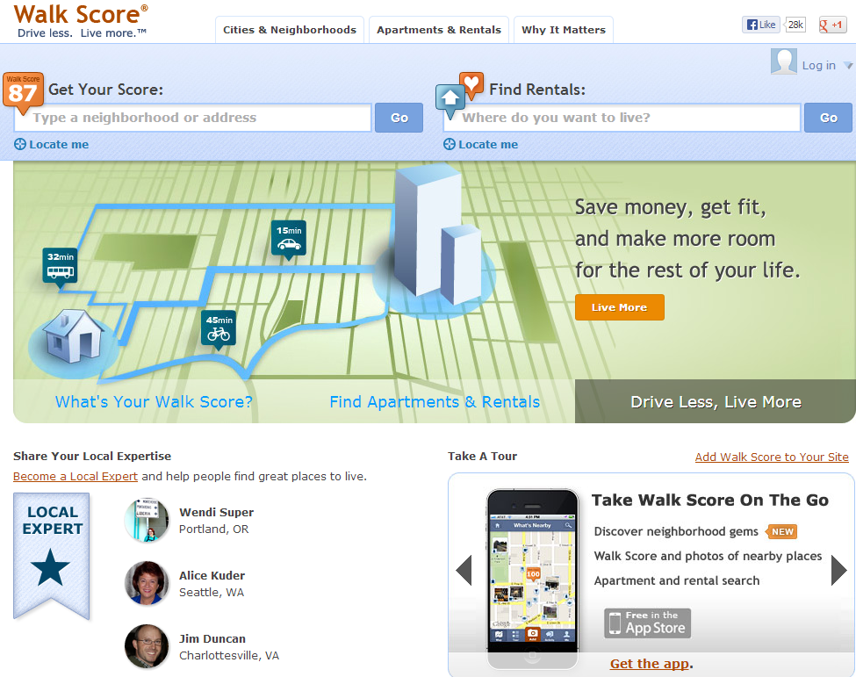
Walk Score
Notes:
This is a walkability index and the namesake of the host company. The company serves more than four million scores per day to over ten thousand participating websites.^{[1]} A Walk Score may be assigned to a particular address or an entire region, and the company maintains a ranking of the most walkable cities in the US, Canada and Now Austrailia.
The CEO, has stated that he wants Walk Score to be a part of every real-estate listing in the future. He envisions the Walk Score of a home to be as important as how many bedrooms or bathrooms the property has. Again showing the importance for Lifestyle. According to the site's creators, "The Walk Score algorithm awards points based on the distance to the closest amenity in each category. If the closest amenity in a category is within .25 miles (or .4 km), we assign the maximum number of points. The number of points declines as the distance approaches 1 mile (or 1.6 km)—no points are awarded for amenities further than 1 mile. Each category is weighted equally and the points are summed and normalized to yield a score from 0–100. The number of nearby amenities is the leading predictor of whether people walk."^{[6]} Relevant amenities include "businesses, parks, theaters, schools and other common destinations
Free

Slide 20
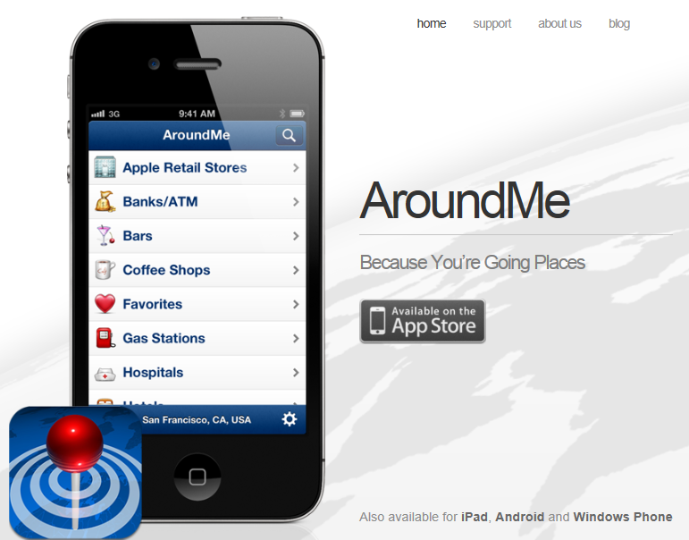
AroundMe
Notes:
AroundMe quickly identifies your position and allows you to choose the nearest Bank, Bar, Gas Station, Hospital, Hotel, Movie Theatre, Restaurant, Supermarket, Theatre and Taxi. AroundMe shows you a complete list of all the businesses in the category you have tapped on along with the distance from where you are.
While people are in your open house, if they have concerns about location, you can handle them instantaneously!
Free

Slide 21
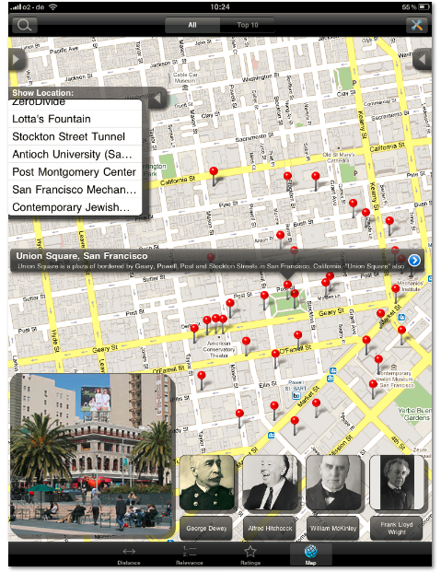
Wikihood
Notes:
Find notable places to visit, anywhere on earth. Wikihood combines Wikipedia and Google Maps, resulting in a surprisingly interesting way to find out what cool things are near a given town or GPS coordinate. Wikipedia has an article on practically everything, so it makes sense to arrange it in many different ways. Wikihood arranges everything on a Google Map, allowing you to explore Wikipedia in a new way.
Again, visitors can see anything of interest around the home. Opportunities are endless
Free

Slide 22
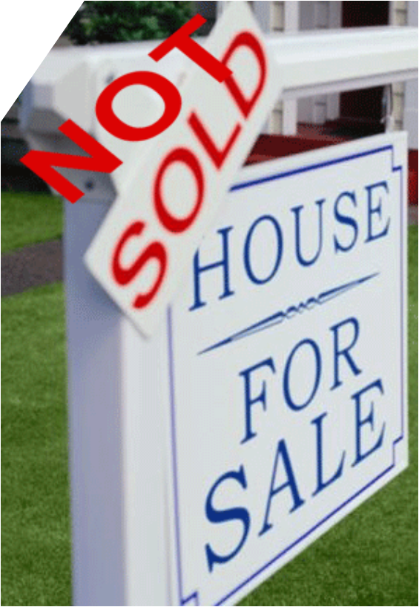
Another Lead Generating Method For Sale By Owner (FSBO)
+ Want to sell
- Want to keep the commission
- May have had a bad experience with an agent
- Agents tend to ‘beat up’ and ‘berate’ the FSBO
Requires a multi-visit, planned, consistent system

Slide 23
Characteristics of FSBOs
10% sold their own homes in 2014, vs. 14% in 2003
Use of RE agents: 87% In 2014 from 82% in 2004
Have lower median incomes/more singles
In 40% of FSBO sales, the seller knew the buyer (!)
FSBOs have a lower median sales price
More than ½ of FSBOs didn’t have urgent need to sell
40% of FSBOs used that method because they didn’t want to pay a commission
Attracting buyers was their most difficult task

Slide 24
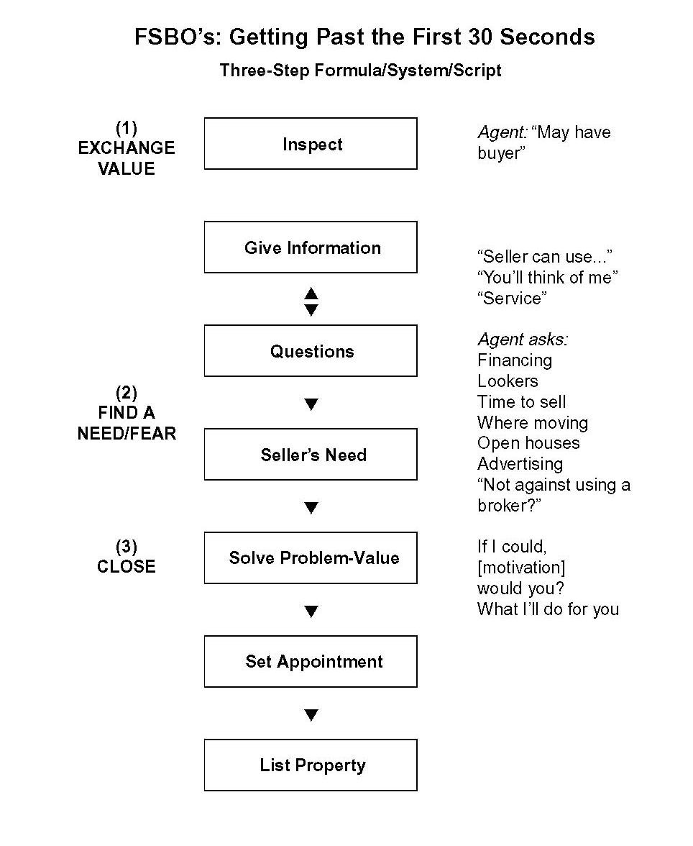
Three Steps to Convert FSBOs
Exchange value
Find a need/fear
Close
This document is available to you

Slide 25
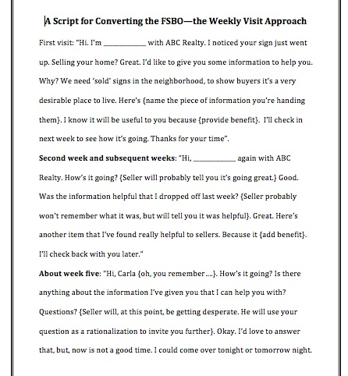
Another Method to Reach FSBOs
FSBOs do something in 6 weeks – sell, list or take off market
This is a low-key method to prove you are trustworthy and consistent
Go back each week; bring something of value
Do your presentation
This document is available to you

Slide 26
What You’ve Accomplished So Far
In Lead Generation:
Called on people you know
Circle prospected
Followed up on Internet leads
Called on expired listings
Held an Open House
Called on FSBOs
In Business Support Activities:
Implemented business start-up plan
Practiced six lead generating methods

Slide 27
More Accomplishments
In Sales Skills:
All lead generating methods with dialogue
Features/benefits substantiated with visuals
AAA objection-busting method
Probing
Dominant Buying Motive
Packaging Systems:
Buyers’ Presentation
Sellers’ Presentation
Follow-up and social media strategies

Slide 28
In this Session, We’ve…
Learned how to optimize the opportunity of an open house
Gotten the 4 skills to get an appointment from an open house
Gained the skills to answer common objections in an Open House
Gotten 2 methods of calling on and converting FSBOs

Slide 29
Recommended Actions to Take Right Now
Practice the role plays with someone so you can master the Open House skills
Schedule an Open House to hold open this weekend (or more than one!)
Prepare your 3 reports for your next session
Do the Recommended Action Plan Checklist
Watch the referenced video available under the Learning Tab in the Greenhouse
Have a wonderful week! Thank you for continuing to work in Seeds of Success!

